Slide 1




Slide 2


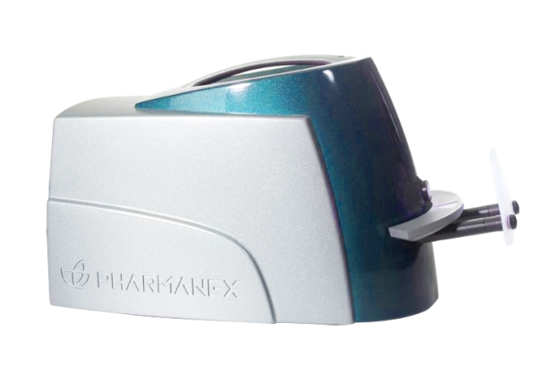
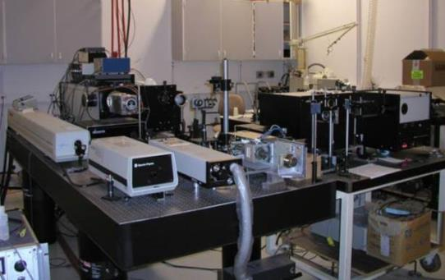

S1
FIRST SCANNER
30 MINUTE WARMUP
15 MINUTE CALIBRATION
pCAL STANDARDS
3 MINUTE SCAN
UNIVERSITY OF UTAH
10’ X 10’
LIQUID NITROGEN REQUIRED
2003
2004
2005
2000
2001
2002

Slide 3
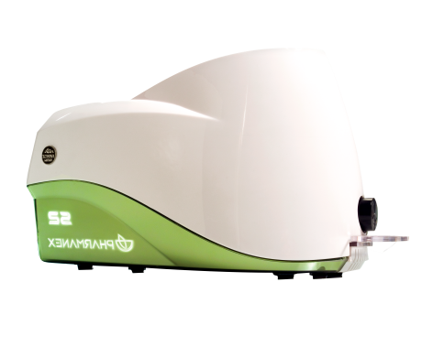
S2
S1
5 MINUTE WARMUP
90 SECOND SCAN
ELIMINATE pCAL WITH EVEREST VERSION
LAPTOP AND BARCODE READER REQUIRED
30 MINUTE WARMUP
15 MINUTE CALIBRATION
3 MINUTE SCAN
pCAL STANDARDS
2006
2003
2007
2004
2008
2005

Slide 4

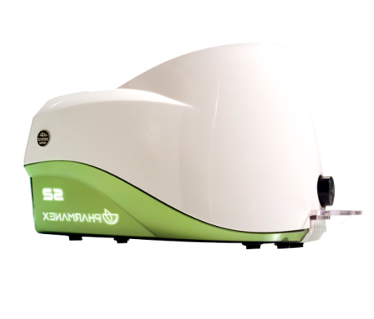
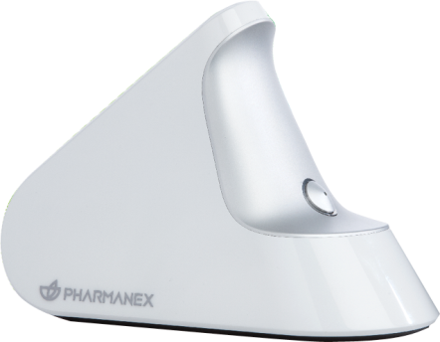
S2
FASTER
5 MINUTE WARMUP
90 SECOND SCAN
ELIMINATE pCAL WITH EVEREST VERSION
LAPTOP AND BARCODE READER REQUIRED
SMALLER
PORTABLE
DIGITAL
2007
2008
2009
INTRODUCING

Slide 5



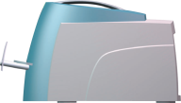

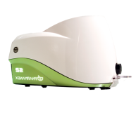

BIOPHOTONIC SCANNER S3
FASTER SCAN TIME
S1
3:00
S2
1:30
S3
0:30

Slide 6






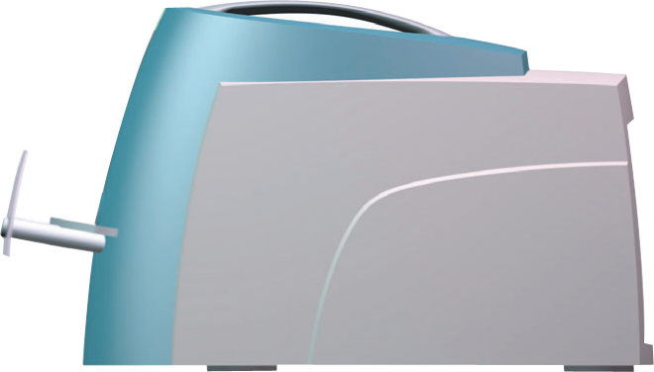

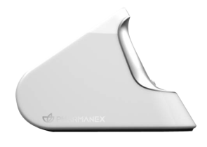
16.5 lbs
11.8 lbs
3.8 lbs

Slide 7



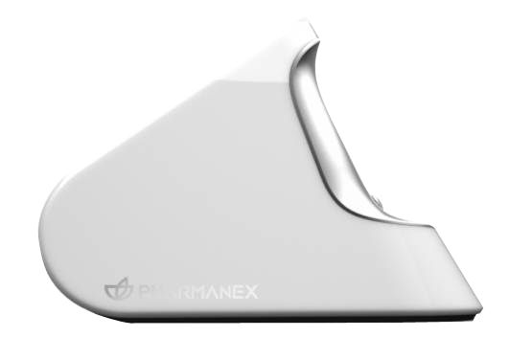



EXTENDED BATTERY LIFE
500+ SCANS ON 1 CHARGE.
YOU’LL RUN OUT OF ENERGY
BEFORE IT DOES
WIRELESS CONNECTIVITY
BLUETOOTH LE. NO WIRES
NEEDED TO PERFORM A SCAN.
iPAD SCANNER APP
IPAD MINI IS USED TO RUN THE
SCANNER WIRELESSLY.

Slide 8
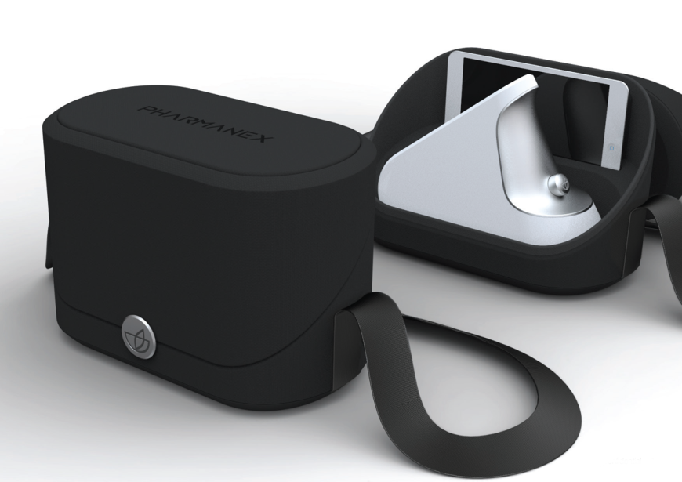

Slide 9



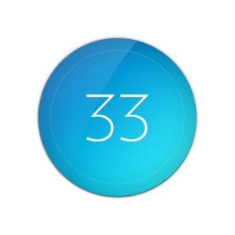
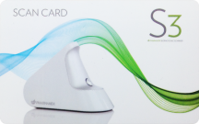
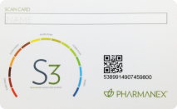
DIGITAL SCANS
NEW OPTION TO BUY AND USE DIGITAL
SCANS.
ELIMINATES THE NEED FOR PHYSICAL
CARDS
SCAN CARDS
USE OF PHYSICAL SCAN CARDS WILL
CONTINUE TO BE AN OPTION

Slide 10


