Slide 1

TRANSFORM YOUR LIFE IN 90 DAYS
Notes:
Introducing the ageLOC TR90 Weight Management and Body Shaping System! These incredible products can help begin to transform your life in 90 days.

Slide 2
HOW DO YOU WANT TO LOOK AND FEEL?
WHAT IS STOPPING YOU?
Notes:
Think about your appearance and your health over the years. Looking forward, how do you want to look and feel?

Slide 3

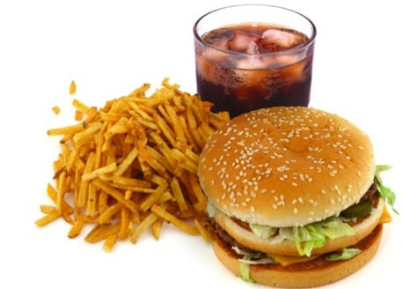


Notes:
Sometimes we sabotage ourselves and let the stresses of everyday life take over. We focus so hard on certain aspects of our life that we forget to maintain a healthy balance. The consequences are easy to list, we don’t get the sleep we need, we don’t make wise food choices, we don’t exercise, and ultimately we end up struggling with our appearance and our weight.

Slide 4
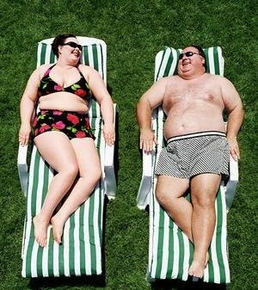
THE RESULT
Notes:
The result? Over time, these habits can make us unhealthy and out of shape!

Slide 5
OF “US” ARE OVERWEIGHT
OR OBESE.
69%
*2010 USA statistics—Center for Disease Control
Notes:
In fact, a 2010 report from the United States Center for Disease Control has stated, “69 percent of North American’s are overweight or obese.” (And Canada is only a little better at 62%)

Slide 6
IT’S
TIME
TO
“DIET”
Notes:
So in the past what has our response always been? “It’s time to diet!”

Slide 7

THE PROBLEM WITH “DIETING”
STARTING WEIGHT
GOAL
But 20-40% of what they lost was lean muscle Less Muscle = Weight Gain
Notes:
In our current paradigm, we starve ourselves or join the latest fad diet. We try and lose as much weight as possible, with some success. However, typically 20-40% of weight lost on a fad diet may be lean muscle mass.

Slide 8



Y
-Y
DIETING
STARTING WEIGHT
GOAL
Notes:
Why Is this? In some traditional diets 20-40% of the weight lost can be lean muscle. Essentially you are decreasing or slowing down your bodies metabolic engine. When you lose lean muscle, your body doesn’t burn fat as efficiently. So what do you do? You diet again and again, repeating a negative cycle, losing more muscle and gaining more weight. And that’s what we call ‘Yo Yo dieting’.

Slide 9



“DIETING” PROBLEMS
Willpower
Cravings
Mood
Energy
Notes:
Another problem with traditional diets is the negative side effects they have on us. People who are dieting often struggle with willpower, cravings, moodiness, and loss of energy.

Slide 10

OR ARE YOU SKINNY FAT?
Notes:
There is another scenario some people find themselves in. Have you heard the term SKINNY FAT? These are people that look thin, but in reality are unhealthy and have a very high body fat percentage.

Slide 11

LOSE THE FAT
WHAT’S THE
SOLUTION?
TRANSFORM
KEEP THE MUSCLE
Notes:
So clearly, losing weight while maintaining lean muscle is a healthy solution to a more fit, younger looking you.

Slide 12
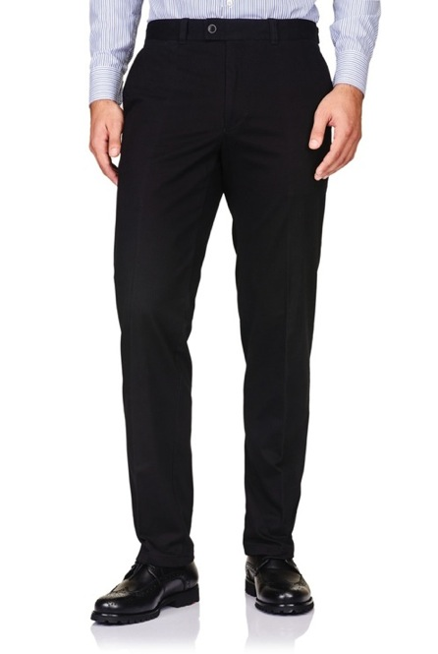


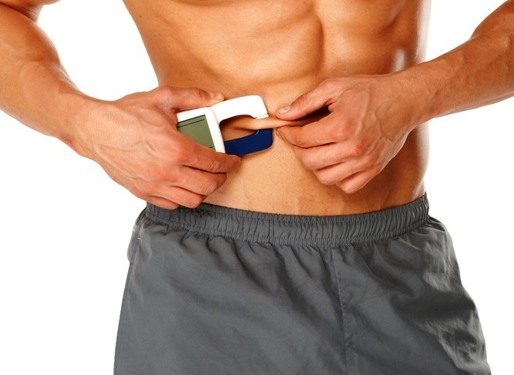
SUCCESS IS NOT JUST THE SCALE ITS...
Inches
Dress Size
Pant Size
Body Fat %
Notes:
Success is so much more important than the number you see on the scale. While losing weight is good, it’s more about the inches lost, fitting into that smaller dress size, wearing the pants you haven’t worn in ten years, achieving a healthier body fat percentage, and most importantly how your feel about yourself!

Slide 13
DON’T JUST LOSE WEIGHT,
TRANSFORM
INTO
A HEALTHY, FIT
YOU!
Notes:
No matter where you fall on the body shape spectrum, you can benefit from making improvements towards a healthier lifestyle and a healthier fit version of yourself. The goal of ageLOC TR90 is not just to lose weight, but to transform your body towards a slimmer, younger looking you!

Slide 14

Introducing a breakthrough
weight management and
body shaping system,
based on highly innovative
gene expression science,
that unifies your mind and
body—for a leaner,
younger looking you.
Notes:
ageLOC TR90 is a breakthrough weight management and body shaping system, based on highly innovative gene expression science, that unifies your mind and body—for a leaner, younger looking you.

Slide 15
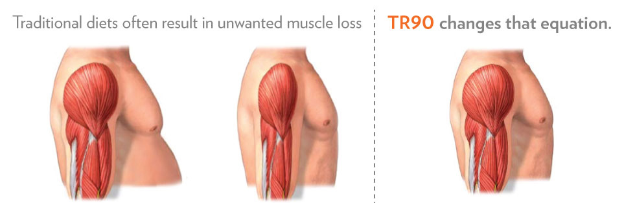
Notes:
Traditional diets often result in unwanted muscle loss. ageLOC TR90 changes that equation.

Slide 16
LEAN MUSCLE = METABOLIC ENGINE
Traditional Diet:
Lose lean muscle
ageLOC TR90:
Maintain more lean muscle
Fat
Fat
Muscle
Muscle
Muscle
Muscle
Metabolic Burn
Metabolic Burn
Metabolic Burn
Metabolic Burn
Metabolic burn = rate at which body burns calories at rest
16
Notes:
ageLOC TR90 is designed to promote a healthy metabolism and lean muscle. In traditional diets you lose everything, fat and lean muscle which results in a weaker metabolism. With ageLOC TR90 you decrease fat and build muscle, creating a stronger metabolic engine that burns fat more efficiently and maintains weight loss better!

Slide 17

MUSCLE =
A LEAN, TONED,
HEALTHIER YOU
Notes:
Muscle equals a lean, toned, healthier you.

Slide 18




Leveraging Gene Expression Science
To unify body and mind in powerful partnership
MIND & BODY
MIND
BODY
Notes:
The comprehensive ageLOC TR90 program also helps address some traditional dieting problems that affect your body, your willpower, and your mood. This is important because when your mind and body are in balance, you have more energy, have a more positive outlook, and are more confident. With ageLOC TR90, it’s time to improve your mood, reduce your cravings, reclaim your willpower, and transform your body.

Slide 19
AGELOC® TR90™
Weight Management and Body Shaping System
Advanced Products
Simple Eating Plan
Active Lifestyle
An advanced weight management system that helps you look leaner and healthier in 90 days.
Notes:
There are three main components to the ageLOC TR90 System, advanced products, a simple eating plan, and an active lifestyle. First let’s talk about the products.

Slide 20
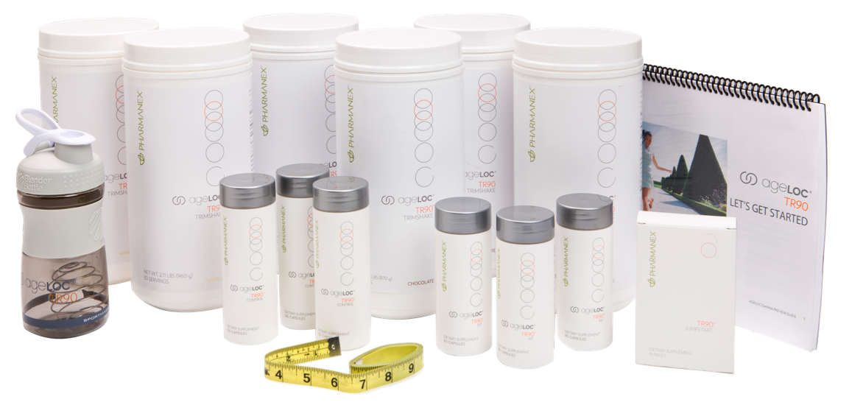
AGELOC® TR90 LTO KIT
* Limited GREENSHAKE option also available.
Notes:
Introducing ageLOC TR90, a clinically proven system of products that are based on highly innovative gene expression science, that unifies your mind and body—for a leaner, younger looking you.

Slide 21

AGELOC® TR90 JUMPSTART
The perfect push to get you primed and ready for success. By resetting your body’s balance, you can see the beginnings of success in just 15 days—and experience all the motivation that comes along with it.
* This statement has not been evaluated by the Food and Drug Administration. This product is not intended to diagnose, treat, cure, or prevent any disease.
Notes:
ageLOC TR90 Jumpstart is the perfect push to get you primed and ready for success. By resetting your body’s balance, you can see the beginnings of success in just 15 days—and experience all the motivation that comes along with it.

Slide 22

AGELOC® TR90 CONTROL
A key component to make it easier to stay focused on the path to success.
* This statement has not been evaluated by the Food and Drug Administration. This product is not intended to diagnose, treat, cure, or prevent any disease.
Notes:
ageLOC TR90 Control is a key component to make it easier to stay focused on the path to success.

Slide 23

AGELOC® TR90 FIT
A great way to get your body back on track with optimum weight management.
* This statement has not been evaluated by the Food and Drug Administration. This product is not intended to diagnose, treat, cure, or prevent any disease.
Notes:
ageLOC TR90 Fit is a great way to get your body back on track with optimum weight management.

Slide 24
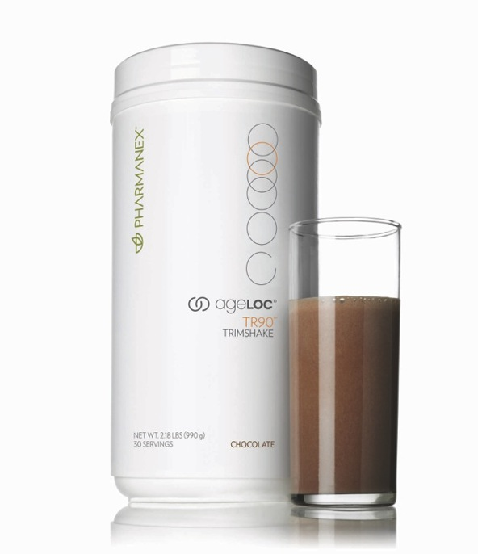
AGELOC® TR90 TRIMSHAKE
An easy and delicious solution that removes the guesswork—giving you the ideal protein you need while helping you control calories.
* This statement has not been evaluated by the Food and Drug Administration. This product is not intended to diagnose, treat, cure, or prevent any disease.
Notes:
ageLOC TR90 Trimshake is an easy and delicious solution that removes the guesswork—giving you the ideal protein you need while helping you control calories.

Slide 25
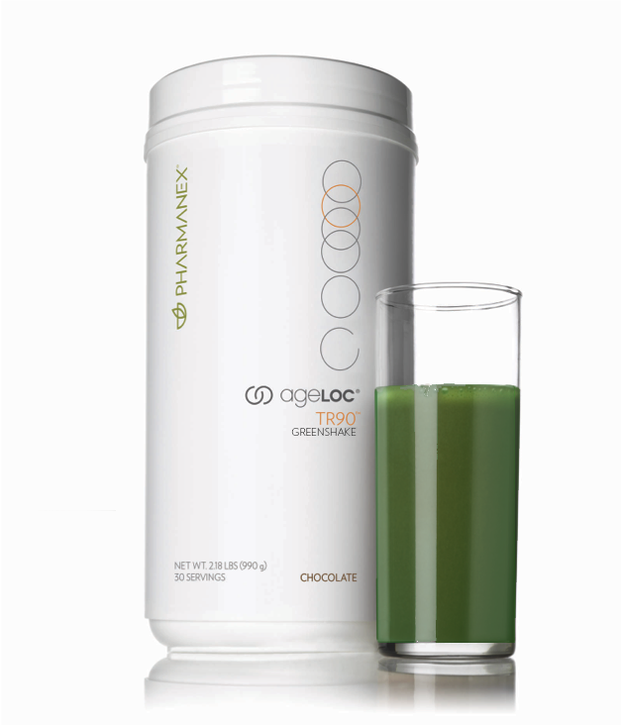
AGELOC® TR90 GREENSHAKE
Lactose free
Gluten free
Soy free
Vegetarian proteins
Greens:
  Wheat Grass
  Alfalfa
  Spirulina
  Chlorella
  Beet Root
  Spinach
  Barley
*Limited availability during the LTO.
Notes:
ageLOC TR90 Green Shake is lactose free, gluten free, soy free and uses vegetarian proteins.

Slide 26
EATING PLAN
3X A DAY
2X A DAY
1X A DAY
Supplement: Fit
30-60 Grams Protein/Meal (Depending on Body Size)*
  Protein Source Options:
  TR90 Shakes (2 x per day)
  Lean Meat, Fish
  Dairy, Eggs, Cheese
  Beans/Legumes
  Nuts, Seeds
Supplement: Control/LifePak
  Snacks
  Snack Options:
  Element Bar
  Fruits
  Vegetables
Supplement: Jumpstart
  1 Non-Shake Healthy Meal
  Meal Components:
  1 Protein
  1 Grain
  1 Fruit
  1 Vegetable
LIMIT Added sugars and processed foods i.e., crackers, white flour/sugar, chips, sugar sweetened drinks and dressings
*Based upon 90 day Target Body Weight, assuming 2 pounds per week weight loss: Target weight in Kgs X 1.6 = total daily intake in protein grams. Example: Current weight 250 lbs. Target weight in 90 days 226lbs. 226/2.2 = 103 Kg x 1.6 = 164 grams of protein per day recommended, divided evenly three times per day, ~55 g protein/meal: Breakfast, Lunch and Dinner.
Notes:
The next component of the system is a simple eating plan. Make sure that three times a day you get 30-60 grams of protein, have two snacks a day and eat one complete meal a day.

Slide 27

ACTIVE LIFESTYLE
Let’s Get Moving! Strive for moderate activity a minimum of 30 minutes, 3 times a week.
Notes:
Finally an active lifestyle is critical to the plan. Strive for at least thirty minutes of moderate activity three times a week.

Slide 28
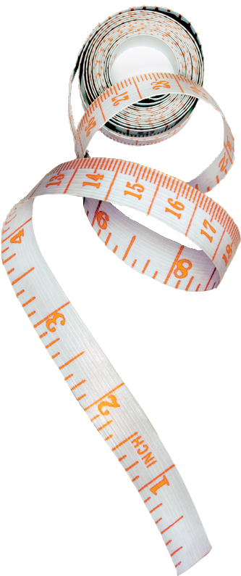
PROMISING CLINICAL RESULTS
Significant decrease in body weight related to fat loss in both genders
Visible decrease in stomach, thigh & calf measurements
Reduced cravings
Hunger decreased at the end of the study
MORE TO COME!
Notes:
Promising clinical results show fat loss, decrease in stomach, thigh & calf measurements, reduced cravings, and decreased hunger.

Slide 29
HOW DO YOU WANT
TO LOOK AND FEEL?
Notes:
So how do you we want to look and feel?

Slide 30
is your solution.
Notes:
ageLOC TR90 is your solution.

Slide 31
TRANSFORM YOUR LIFE IN 90 DAYS
Notes:
So make the commitment now to transform your life in 90 days!

