Slide 1

Notes:
Created by J. Engemann, S. Ferguson
Approved by A. Mastaloudis, T. Whitehead

Slide 2





Slide 3

Nu Skin Is the Premier Anti-Aging Company
Scientific innovation has established Nu Skin as a global leader in the nutritional and personal care industries. Our proprietary processes enable us to set new industry standards in anti-aging, with real solutions that exhibit demonstrable results.
Notes:
Read slide

Slide 4
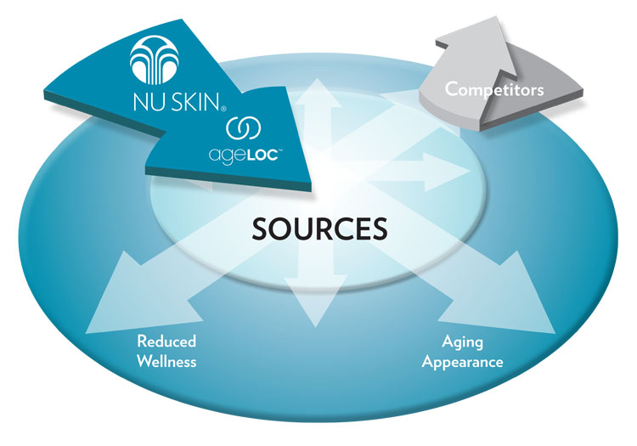
Target the Sources of Aging
Notes:
Competitors in the skin care and nutrition industries merely address the signs and symptoms of aging, such as an aging appearance or reduced wellness. ageLOC Science targets the sources of aging (genes), not just the symptoms.

Slide 5
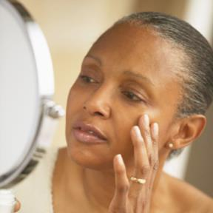

Concerns with Aging
Two most common complaints with aging are
Looking
Older
Feeling
Older
Notes:
- As you know we are an anti-aging company. With aging comes two primary complaints – one would be the way we look. The lines, wrinkles, discolored, sagging skin. The other is how we feel.
- Now I am sure you are aware that we have made great strides with the problem of looking older with ageLOC skin care products.

Slide 6
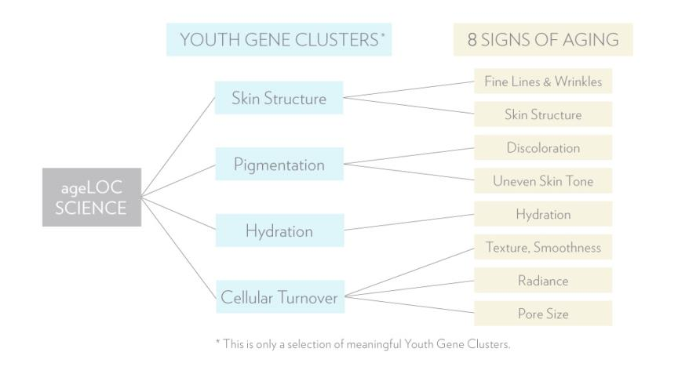
Youth Gene Clusters for Skin
Notes:
ageLOC Science has already identified, targeted and reset Youth Gene Clusters in the skin. Four YGCs were identified, which targeted eight key signs of aging.

Slide 7

Concerns with Aging
Two most common complaints with aging are
Looking
Older
Feeling
Older
Notes:
- Realize that with regards to skin care we have only just begun our 10 year development cycle studying the genetic basis of aging. We will certainly have many more exciting discoveries to come.
- This year we will get to unveil some of the work our Pharmanex scientists have been performing to address what happens inside as we age.

Slide 8

A Global Consumer Need
85% of consumers are concerned about their energy and stamina levels
40% decline in ability to concentrate, from age 30 to 60
As we age, sexual desire declines ~66% in women and ~37% in men
Datamonitor: Global Consumer Fatigue Report. April 2009
Notes:
Loss of vitality is one of the first signs of “feeling older” that people notice.
read stats

Slide 9

What Is Vitality?
Three Dimensions:
Physical (endurance, stamina, resistance to fatigue)
Mental (cognition, clarity, focus, memory, alertness)
Sexual (desire, libido)
Notes:
Loss of vitality is one of the first signs of ‘feeling old’ that people mention as they age.

Slide 10
Vitality Declines With Age
Age-Related Vitality Loss
As we age, our bodies’ ability to effectively generate and utilize energy declines, which may rob us of youthful vitality.
Vitality
Age

Slide 11
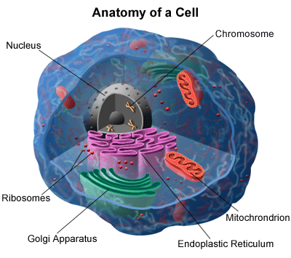
Mitochondria: A Key Source of Youthful Vitality
Mitochondria
Mitochondria
Endoplasmic Reticulum
Notes:
Inside each of our cells, and throughout our body are tiny “cellular power plants” called mitochondria. They produce cellular energy, the chemical energy of life.
Mitochondria are the key source of youthful vitality.

Slide 12
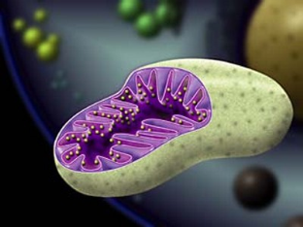
Mitochondria are the cellular power plants that convert energy from food (Kcals) into a form of energy our cells can use—ATP
ATP fuels all biological functions
With age, mitochondria number and efficiency declines dramatically
Functional changes in the mitochondria have been tied to age-related vitality loss
Notes:
Read slide

Slide 13
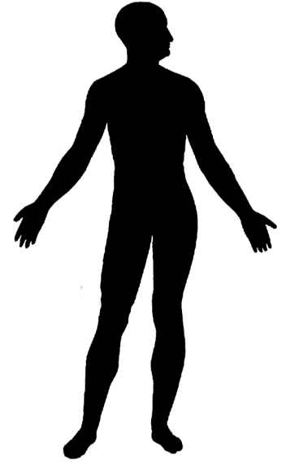


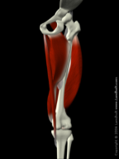
Mitochondria Highly Concentrated In:
Brain
Heart
Muscle
Notes:
There are three key tissues associated with vitality (Brain, Heart, Muscle). They have a lot of mitochondria.
- Together with our research partners, we discovered that as we age, the activity patterns of YGCs that govern our mitochondria shift, contributing to a loss of vitality.
- Mitochondria are most concentrated in the brain, heart, and muscle. As mitochondrial efficacy declines in these organs, they do not act as youthfully. I’m sure we’ve all witnessed this.
We have therefore focused our research on these tissues because they are most concentrated with mitochondria.

Slide 14
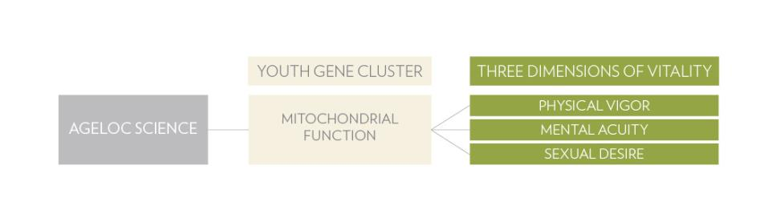
Latest ageLOC Discovery
Identified and influenced 52 genes tied to mitochondrial function.
Notes:
From the 372 mitochondrial-related genes we identified that changed with age, we affected 52 of these genes as the Mitochondrial Youth Gene Cluster (mtYGC). This represents key genes tied to mitochondrial aging.

Slide 15
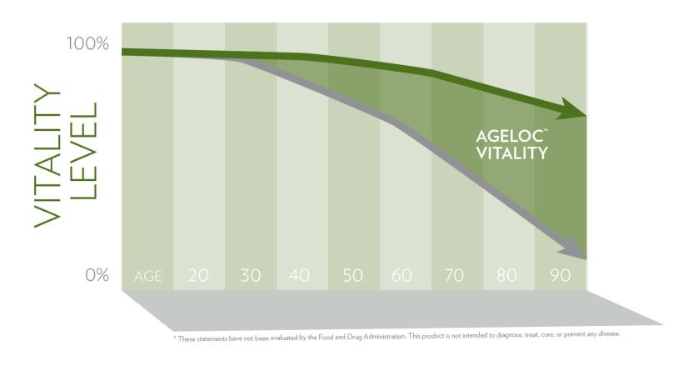
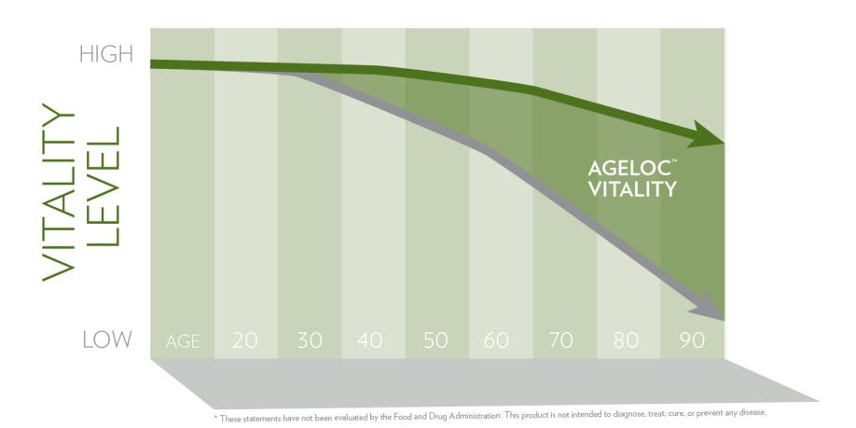
Restore Youthful Vitality
ageLOC Vitality targets the sources of age-related vitality loss by promoting healthy YGC activity.*
* These statements have not been evaluated by the Food and Drug Administration. This product is not intended to diagnose, treat, cure, or prevent any disease.
Notes:
- ageLOC Vitality targets the sources of age-related vitality loss.
- Remember the natural energy you had ten years ago? Wouldn’t you like to feel that way again?

Slide 16
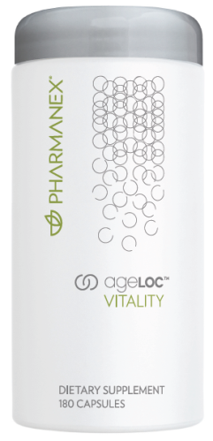
ageLOC Vitality
Promotes Three Dimensions
of Vitality:*
Physical Vigor
Mental Acuity
Sexual Desire
Reset, Revive, Renew
with ageLOC Vitality
* These statements have not been evaluated by the Food and Drug Administration. This product is not intended to diagnose, treat, cure, or prevent any disease.
Notes:
- ageLOC Vitality improves the three dimensions of vitality—physical vigor, mental acuity, and sexual desire— by promoting healthy YGC activity associated with youthful vitality. Through targeting the sources of age-related vitality loss, ageLOC Vitality helps you feel more like you did when you were young.

Slide 17
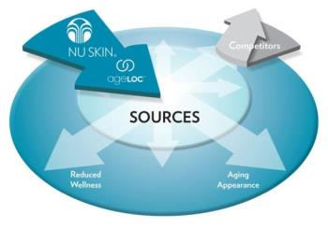
Key Takeaways
ageLOC science can identify the ultimate sources of age-related vitality loss
ageLOC can target the Youth Gene Cluster related to mitochondrial function, the key driver of youthful vitality
ageLOC can reset this Youth Gene Cluster to promote youthful vitality
Notes:
Read slide

Slide 18


