Slide 1

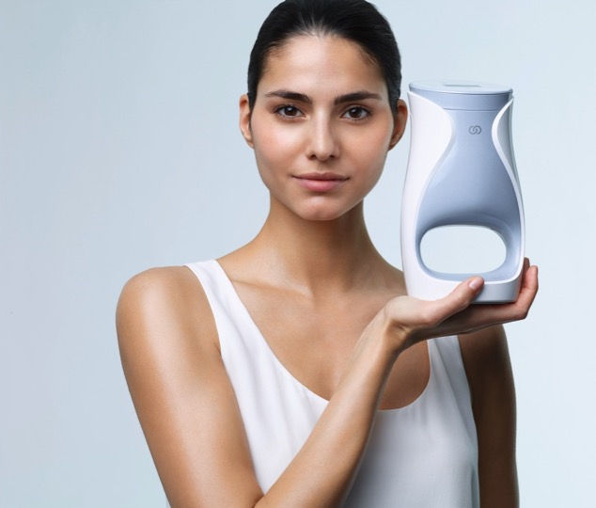
LET’S TALK ABOUT
Notes:
Let’s talk about me. Not ME, but ageLOC Me. Because it’s so personal and individual that it’s really about you, and me, and all of us.

Slide 2
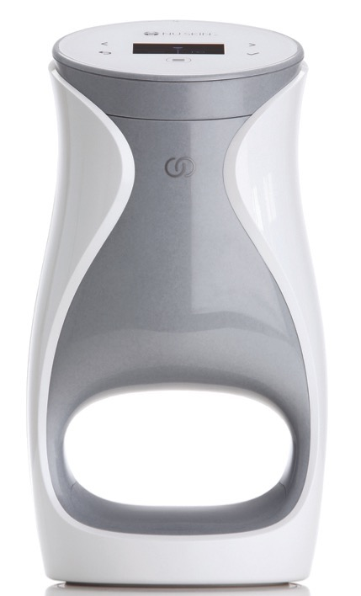
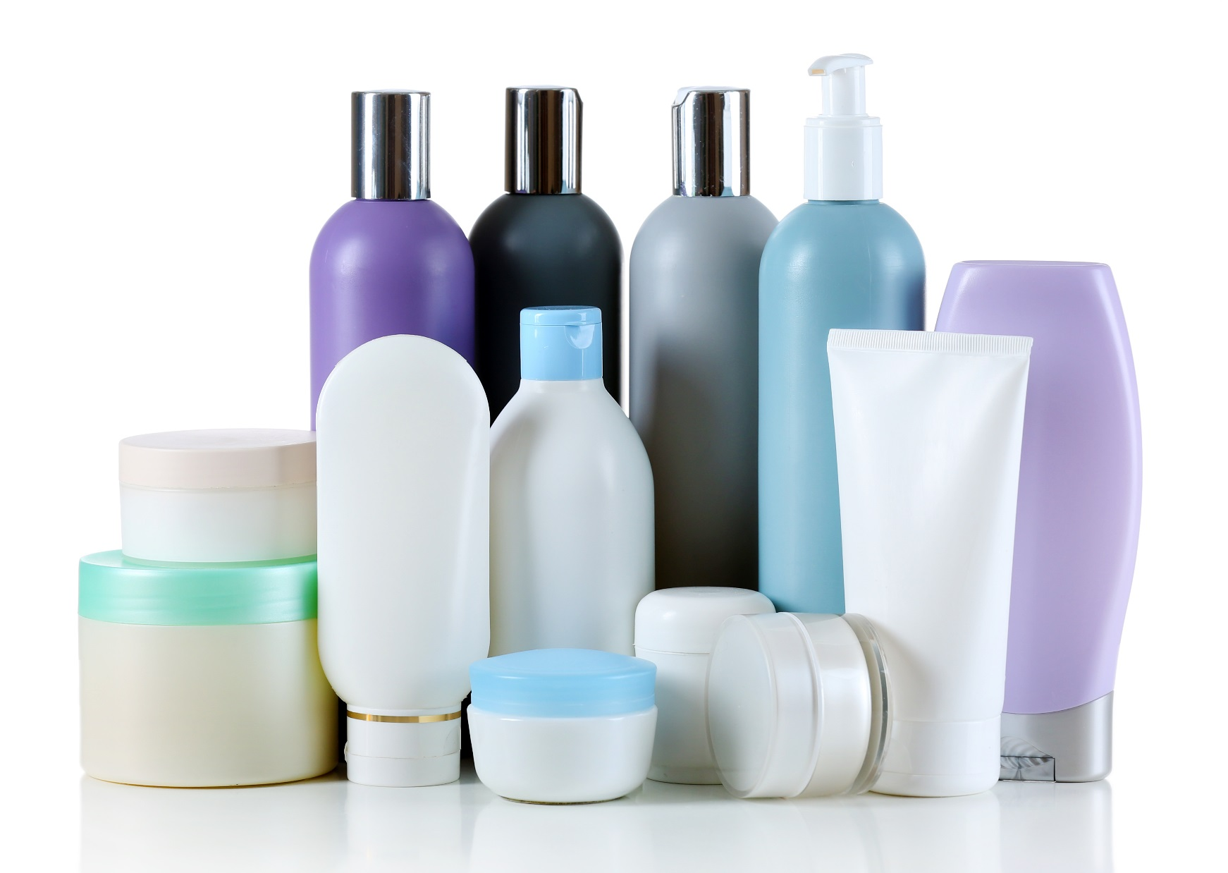
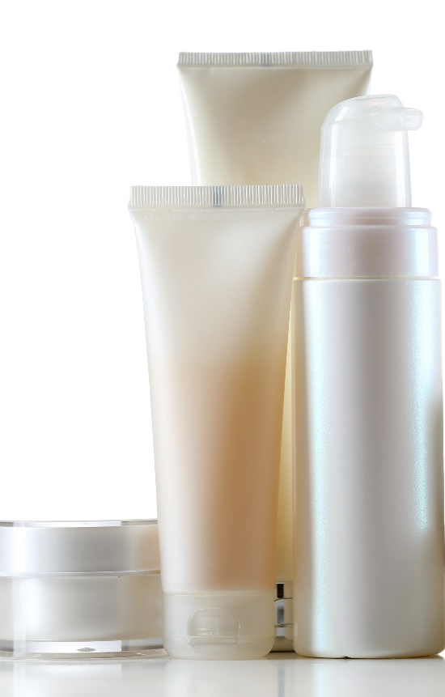
let’s talk about me
CONVENIENT AND EASY TO USE
Notes:
There are millions of products in the global beauty industry. Some people are really good at curating their own regimens and know what they want. Others, however, are intimidated by skin care and may be confused by all the options that are available. They may not know what’s right for them. That’s what is so great about ageLOC Me. Even if you’re a skin care novice, you can easily find a regimen that will deliver the best results for your skin.
With ageLOC Me, you don’t need to crowd your vanity or bathroom cabinet with dozens of bottles, tubes, and jars. ageLOC Me is simple, convenient, and easy to use.

Slide 3
let’s talk about me
let’s talk about m
NEXT GENERATION SKIN CARE
30 years anti-aging genetic science
Targets the sources of aging
Hyperpigmentation and age spots
SPF or SPF-free
Fragranced or fragrance-free.
Smoother, softer texture

Slide 4
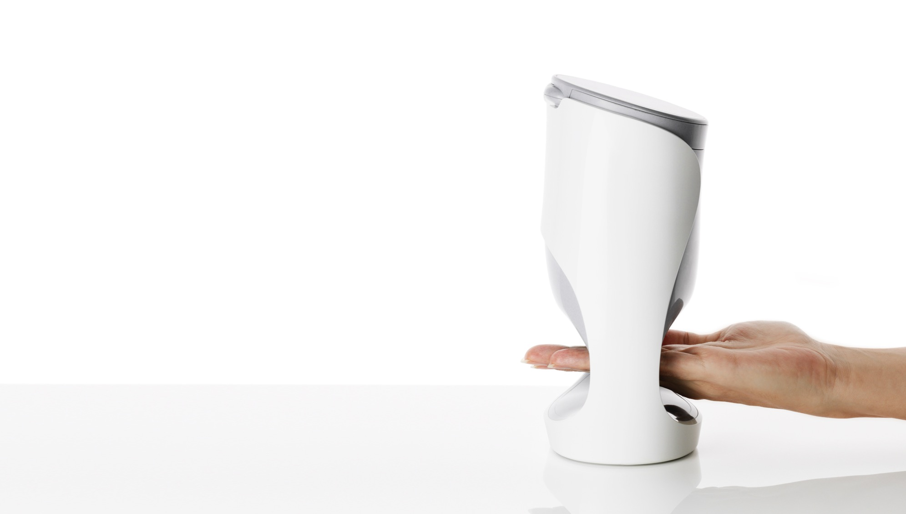
Increases skin radiance
Helps reduce pore size
Improves the appearance of lines and wrinkles
Contours and firms
Hydrates and strengthens
Calms, soothes, rejuvenates
Suitable for different skin types

Slide 5
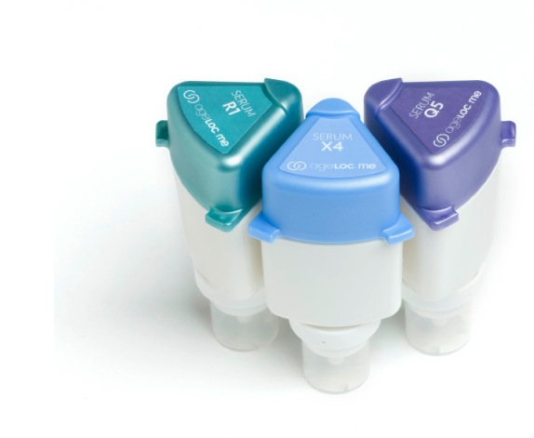
AGELOC ME™ SERUMS
Helps with Cellular Turnover
Diminishes Pigmentation
Helps Target Lines/Wrinkles, Firmness
Notes:
Cellular Turnover
Specialized ageLOC Me Serum helps improve cellular turnover to refine texture, reduce the appearance of pores, and reveal smoother, softer skin—for a noticeably younger looking you.
Pigmentation
Specialized ageLOC Me Serum helps prevent the visible signs of hyperpigmentation and age spots to reveal more even, radiant skin—for a noticeably younger looking you.
Lines/Wrinkles, Firmness
Specialized ageLOC Me Serum helps improve the visible signs of lines, wrinkles, and sagging—for a noticeably younger looking you.

Slide 6
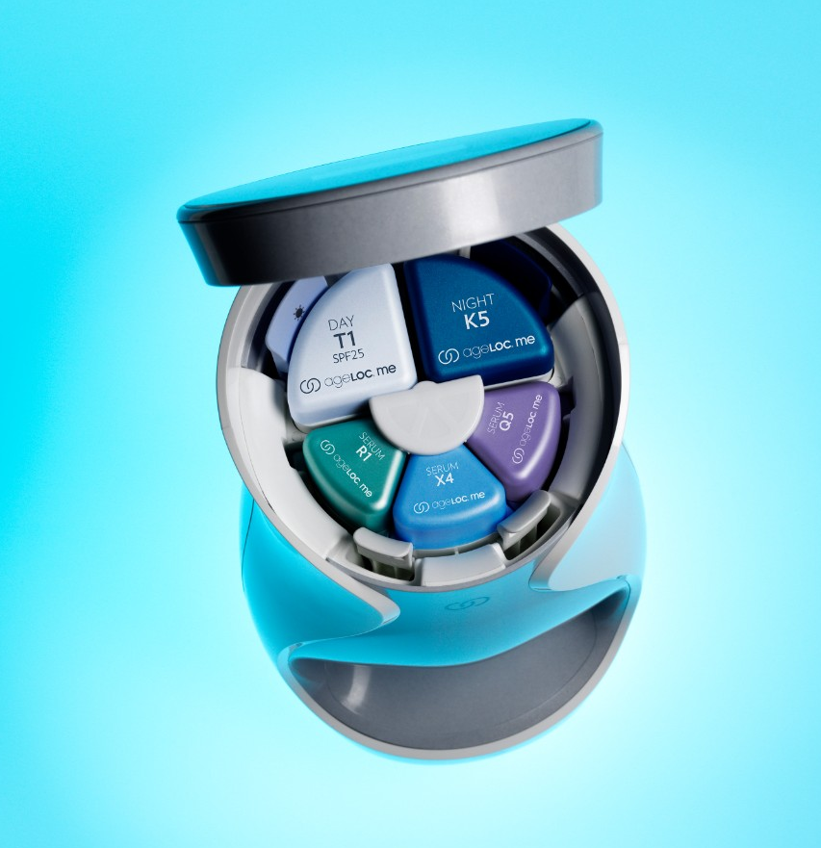
SUPER SERUMS
Higher concentration of active ingredients
Combine to provide a higher amount and potency of key ingredients that could not be formulated into a single product
Notes:
Designed with customization in mind, we have separated the “treatment” products into three separate serums. This novel approach allows for three targeted serums with ingredients focused on particular skin concerns that combine prior to use. So not only does it allow for customization, but it enables a larger array of key ingredients at potentially higher concentrations than what we could easily formulate into a single product. This results in a better product for you.

Slide 7
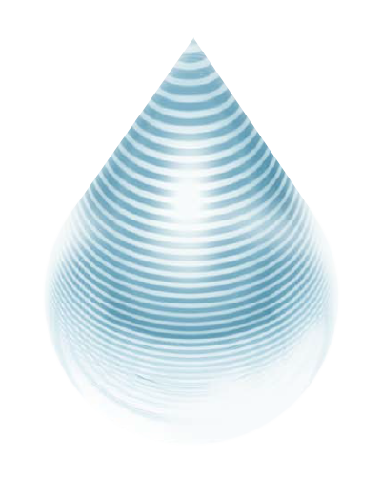
REVOLUTIONARY
MICROLAYERING TECHNOLOGY
The ageLOC Me™ device weaves the customized serums together into 40 layers to evenly distribute key ingredients, optimizing the serum combination and resulting in increased absorption into the skin.
Notes:
Some people say it looks great, and it sounds great, but what’s really happening inside the device? How can you deliver better ingredients in a more efficacious way than we historically have? The answer is our proprietary microlayering technology. The ageLOC Me device weaves the customized serums together into 40 layers and delivers them at the moment of use, evenly distributing the key ingredients, optimizing the serum combination, and resulting in increased absorption of anti-aging formulations into the skin.

Slide 8
THE RESULT: 3x MORE PENETRATION/ABSORPTION INTO SKIN* AND
MORE ACTIVES DISTRIBUTED EVENLY INTO THE SKIN—BETTER RESULTS
AGELOC ME MICROLAYERING TECHNOLOGY™ WITH AGELOC ME DEVICE
Serums
R
X
This image is of a cross-section drawing of skin (stratum corneum)
3x
Q
* Combining the three serums using the ageLOC Me device (ageLOC Me microlayering technology) results in improved absorption into the skin as compared to hand mixing.
* “Absorption into the skin” refers to the stratum corneum.
* 3x was calculated by dividing the average data points of combining through device (microlayering technology) vs. hand mixing
Stratum Corneum
This chart shows each serum is evenly distributed using microlayering technology; thus all three serums maintain their active power.
MIXED BY HAND WITHOUT AGELOC ME DEVICE
R
Serums
X
This image is of a cross-section drawing of skin (stratum corneum)
Q
Stratum Corneum
This chart shows serums not evenly distributed because they were mixed by hand.
Notes:
Nu Skin (2015). [In-Vitro Data Illustrating the Differences in Skin Absorption Based on Combination Methods of ageLOC Me Serums]. Unpublished raw data.
During our development we were concerned that combining the three serums inadequately would allow for hot spots or missed areas on the skin. We have identified that through the ageLOC Me device the serums are evenly dispersed. This ensures that all three serums are adequately spread throughout the combination prior to application on the skin, therefore when applied each serum will reach and is equally represented in all areas of the application site—your face.
Additionally, we commissioned a third party testing house to measure the differences in absorption of a key ingredient when the serums are combined via the ageLOC Me device versus when the device was not used. Amazingly, the ageLOC Me Device combination resulted in three times better absorption into the stratum corneum than the non-ageLOC Me serum combination. This shows another benefit of the ageLOC Me Device; it is undoubtedly a key part of the ageLOC Me System.

Slide 9
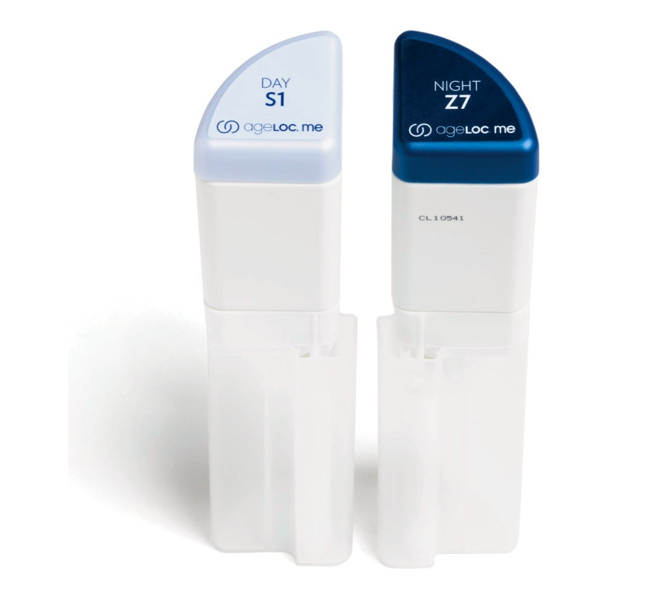
AGELOC ME™ MOISTURIZER BENEFITS
Moisture Barrier
Calms, soothes, and rejuvenates
Customize for Skin Type
Customize for Texture
Customize for Fragrance
Customize for SPF
Notes:
Provide hydration to strengthen and maintain the skin’s natural moisture barrier
Day Moisturizer provides optional broad spectrum protection from UVA and UVB radiation with SPF 20/25
Night Moisturizer calms, soothes, and rejuvenates skin during its natural nighttime recovery process
Formula combinations are suitable for different skin types, including dry, normal, combination, and oily skin.
Offer different options for texture and overall feel based on climate, skin type, and personal preference
Customizable elements include fragrance/non-fragrance and SPF/non-SPF

Slide 10
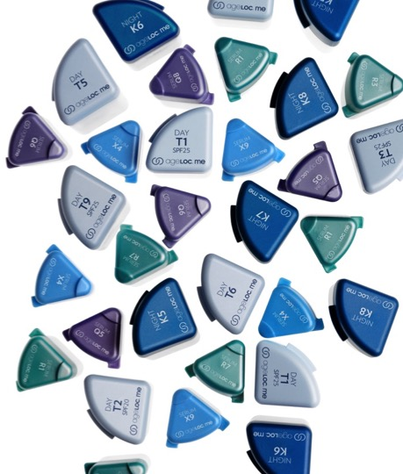
let’s talk about me
let’s talk about me
Core Sets vs Full Sets
Notes:
ageLOC Me Core Customization Sets cost $99.00, and focus on skin type (dry, normal/combination, oily), options for fragrance or fragrance free, and your choice of SPF or SPF-free. ageLOC Me Full Customization Sets cost $149.00, and focus on the items listed above as well as: climate, sun and chemical exposure, skin texture, level of moisturization, ethnicity, skin sensitivity, skin discoloration, lines and wrinkles, and radiance.
The ageLOC Me Reference Set sits right in the middle of the spectrum from super oily skin to super dry skin as well as in the middle of targeting signs of aging. The Reference Set is designed for normal skin types with gentle focus on anti-aging, to allow the widest range of people to use it without irritations. The Reference Set is also priced at $99.00.
ageLOC Me Core & Full Customization Sets contain ageLOC ingredients similar to ingredients in ageLOC Transformation. The ingredients in ageLOC Me Core and Full Sets target the same sources of aging as ageLOC Transformation (the 8 ways) there is just newer technology involved. ageLOC Me Core Customization Sets will be more like ageLOC Transformation than Nutricentials. Both the Core Sets and Transformation sit closer to the middle spectrum trying to target the widest ranges of skin possible. ageLOC Me Full Customization Sets get much more specific and targeted. If you noticed from the first paragraph ageLOC Me Core targets about 3 main things (pretty general) while ageLOC Me Full targets about 12, which reflects the price differences.

Slide 11
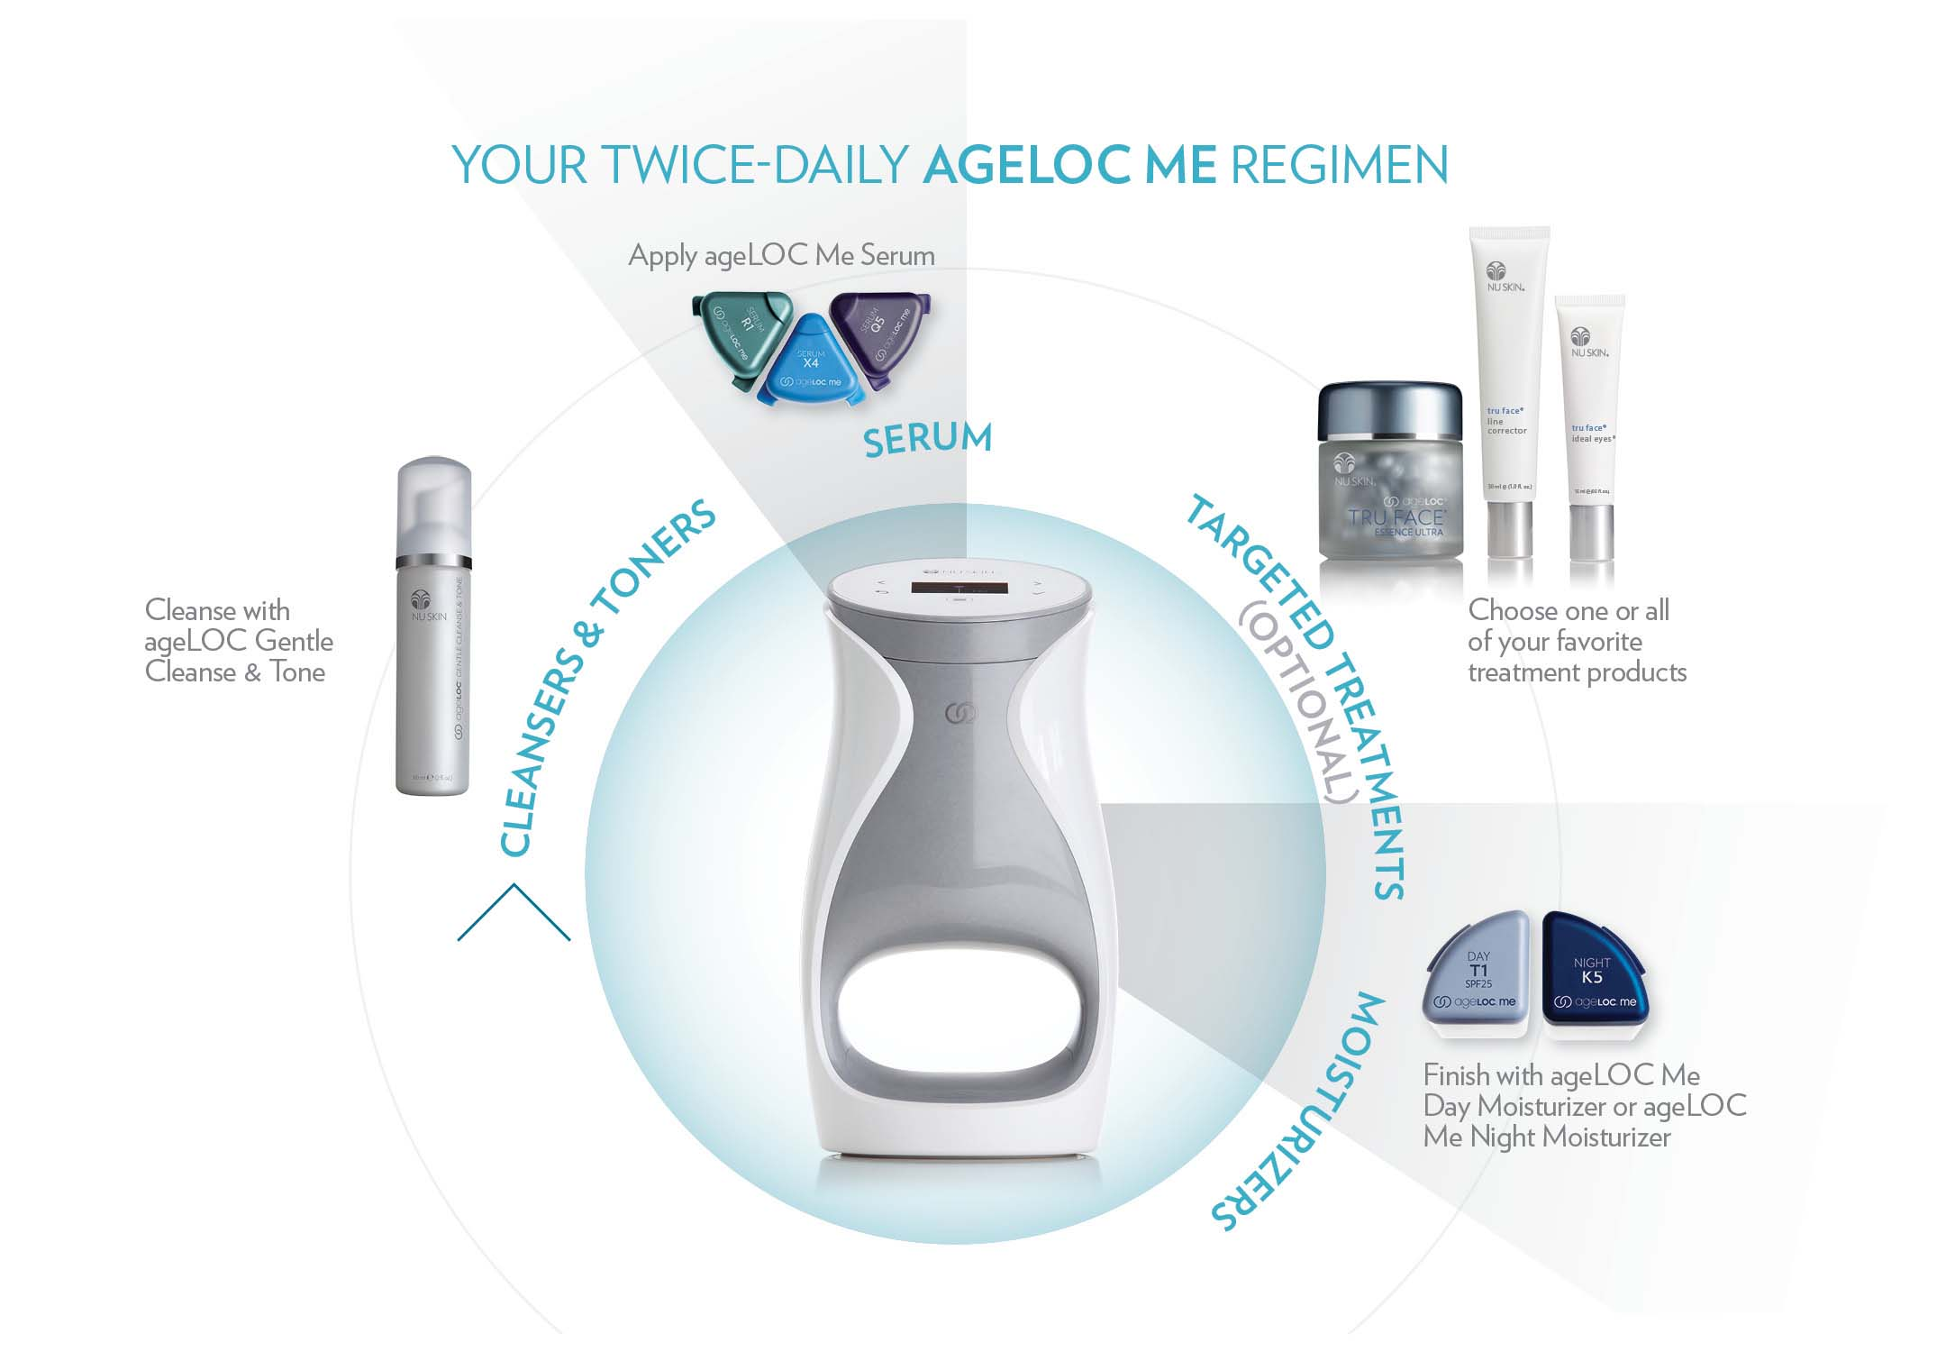
Notes:
And of course all the other Nu Skin products you know and love can fit easily into your ageLOC Me regimen.

Slide 12
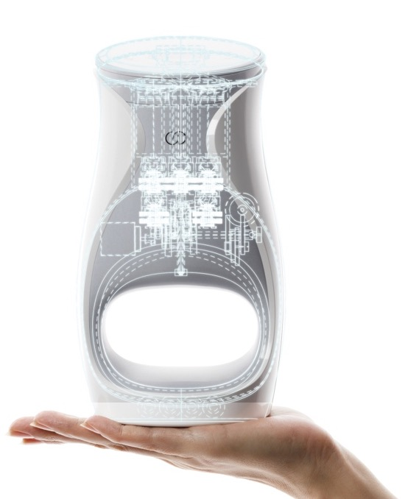
your personal skin care lab
let’s talk about me
WORLD-CLASS ENGINEERING
27 ageLOC® patents or patents pending
5 of which are for ageLOC Me
Notes:
We protect our intellectual property. ageLOC Me employs world-class engineering and is exclusive to Nu Skin—and only YOU have the ability to share it with the world. Our proprietary ageLOC science boasts 27 patents or patents pending. This means no other company on the planet can offer this level of innovation.
And in case you’re wondering, 5 of the 27 patents cover ageLOC Me’s mechanisms for delivering customized skin care to you.

Slide 13
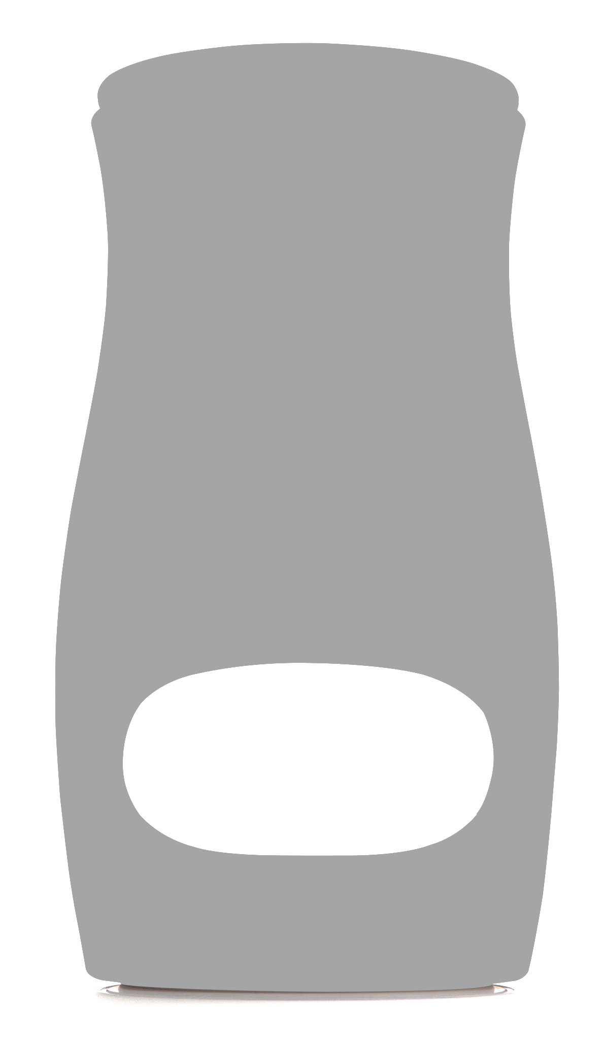
your personal skin care lab
$35
million
invested
Notes:
We decided to change the landscape of the skin care industry and we invested our time, passion, and financial resources to bring ageLOC Me to you and your customers. ageLOC Me represents the most ambitious product development endeavor in Nu Skin’s history.
After several years of intensive research and development and a more than $35-million investment, we have invented a skin care system with product formulations customized to you.

Slide 14
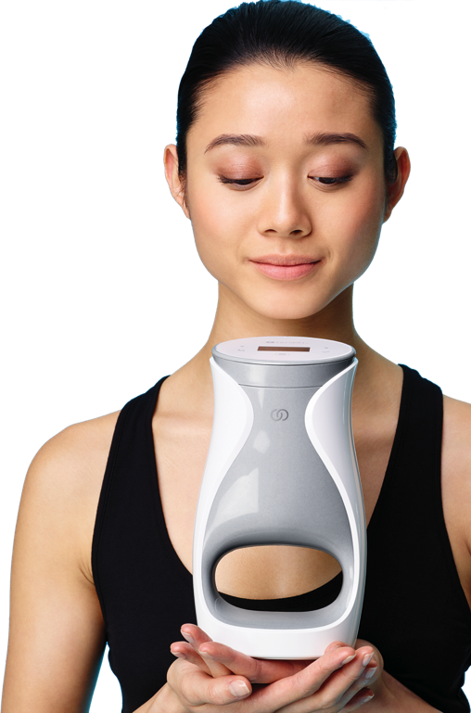




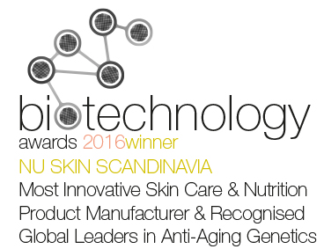


your personal skin care lab
WORLD-CLASS DESIGN
Notes:
Nothing like ageLOC Me has ever been done before and it is truly a breakthrough in the beauty industry. So far, we’ve received these awards for our design and innovation.

Slide 15
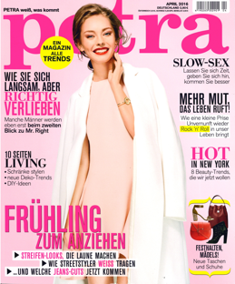

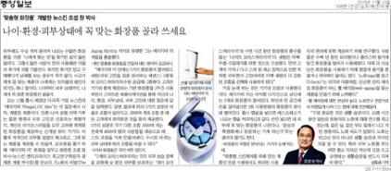
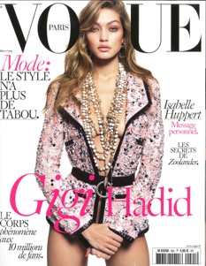

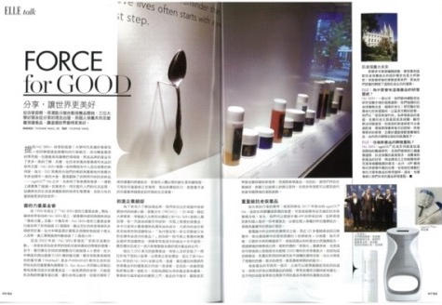
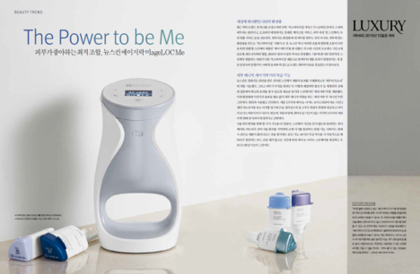
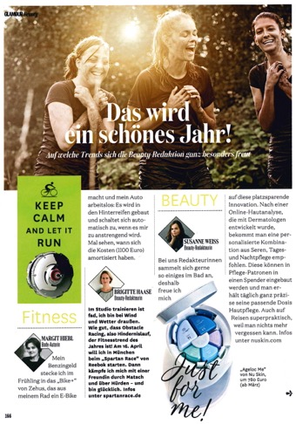
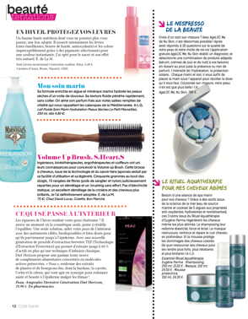
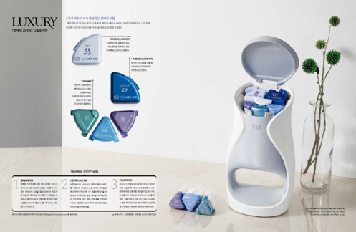
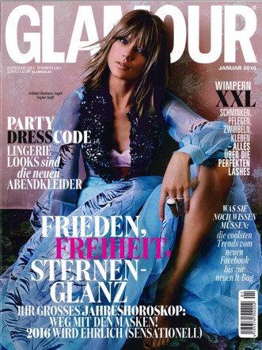
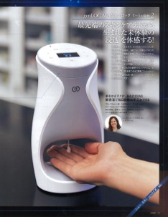
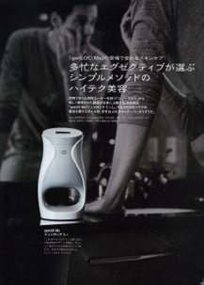
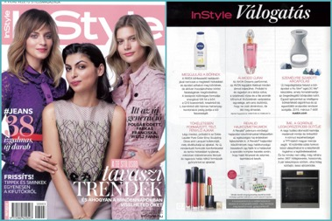


Slide 16
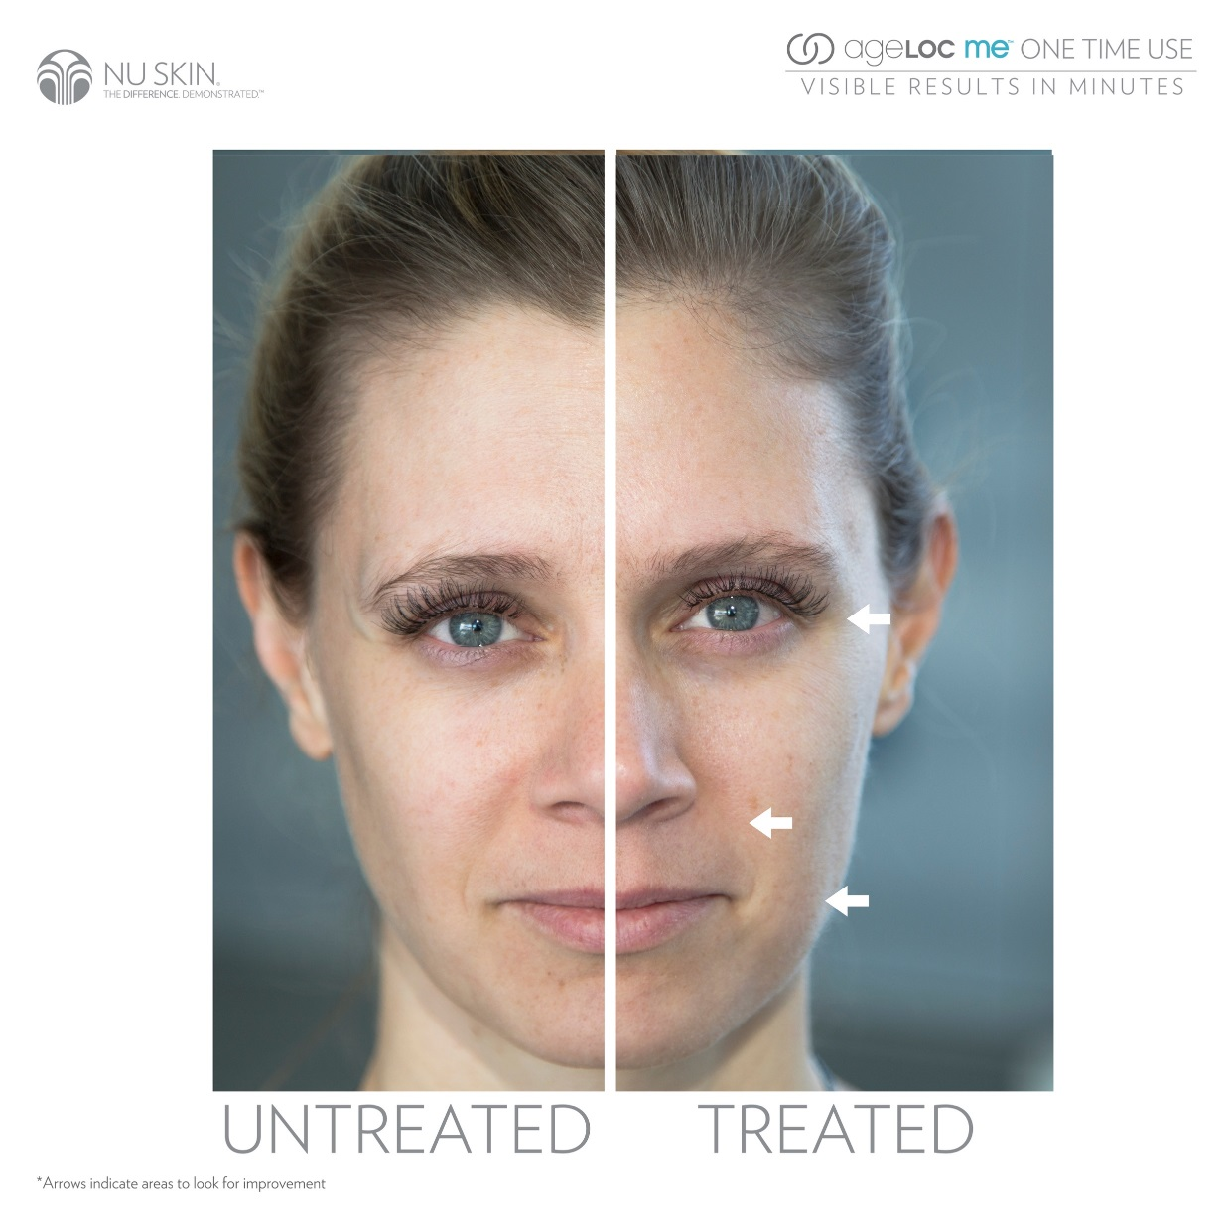

Slide 17
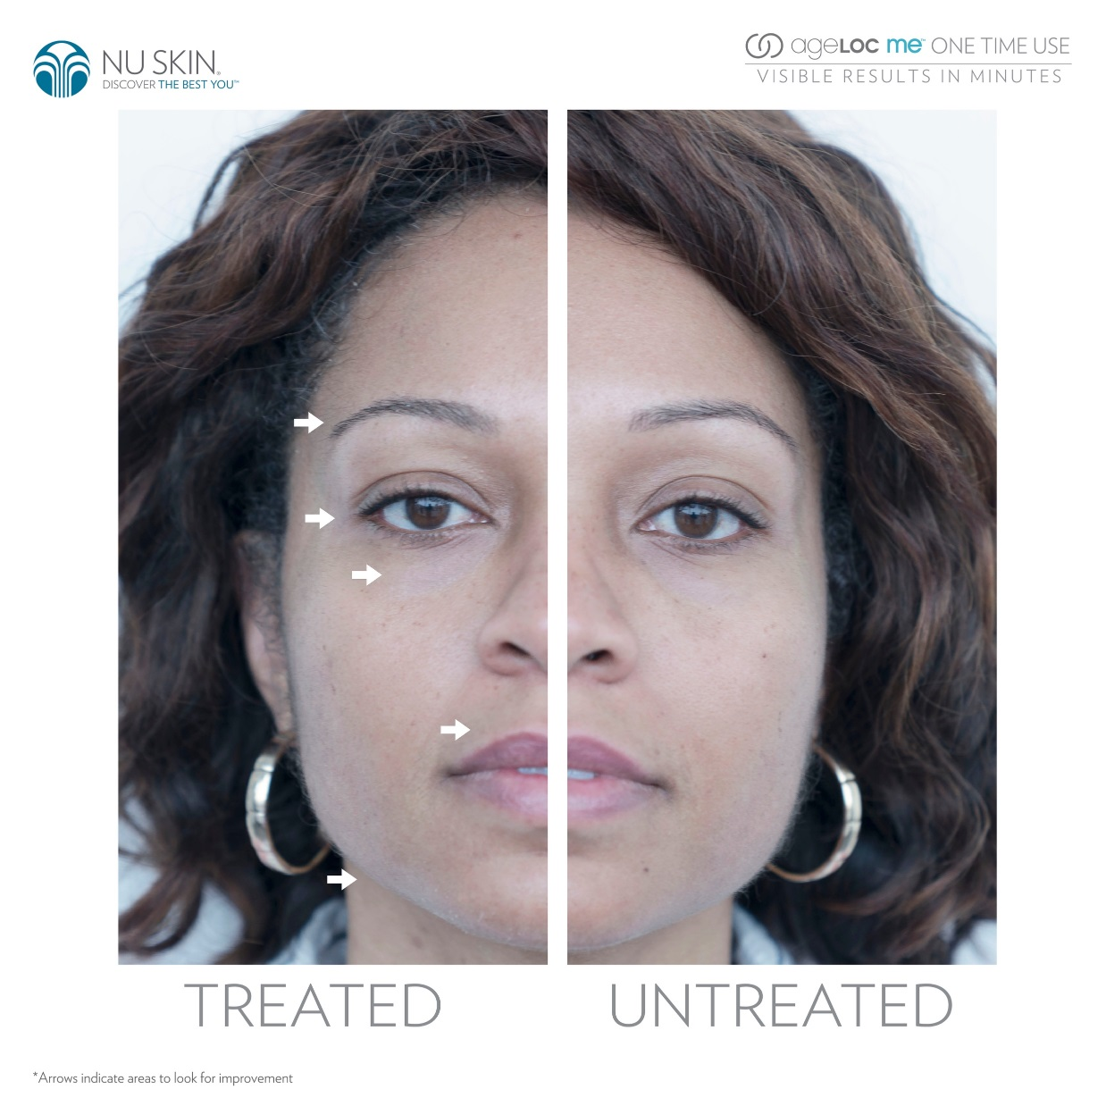

Slide 18
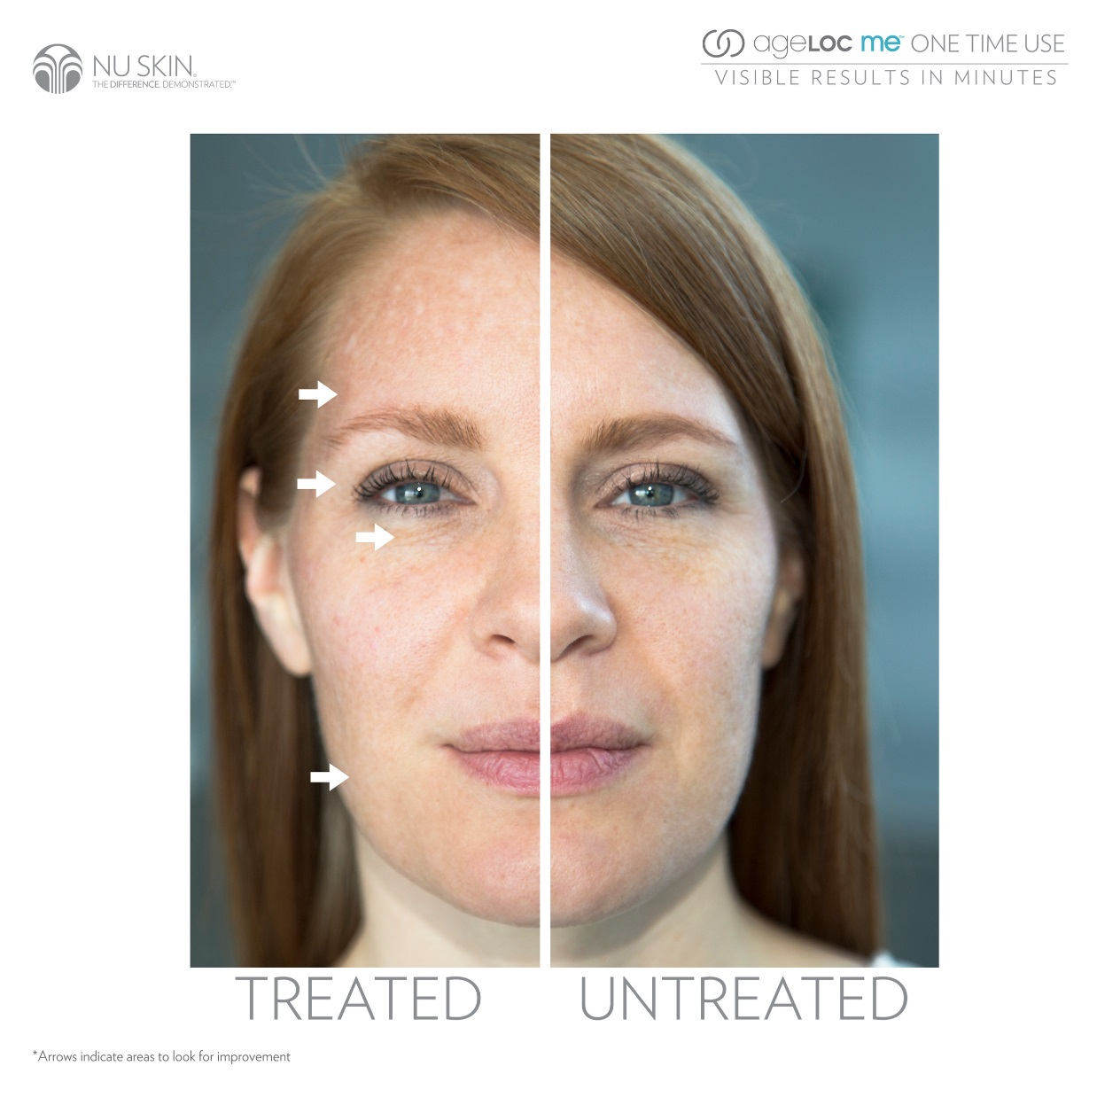

Slide 19
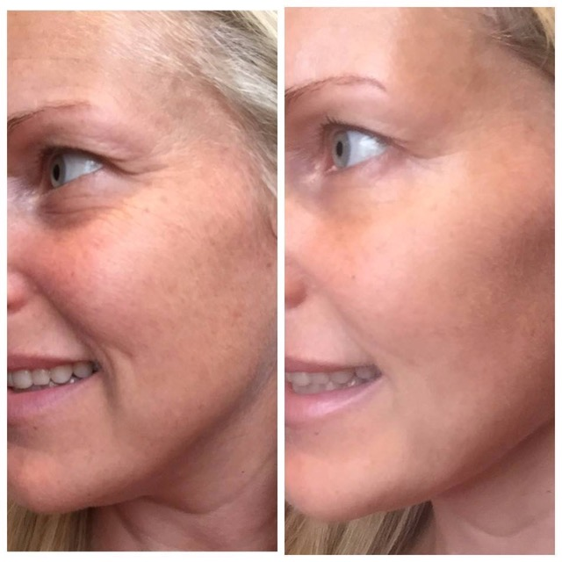

Slide 20
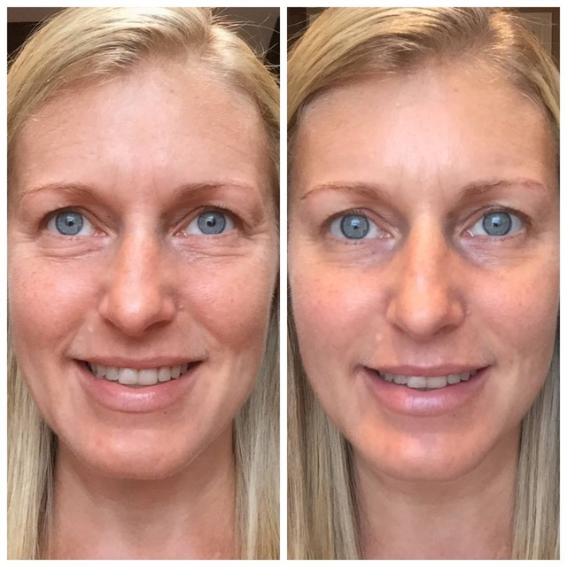

Slide 21

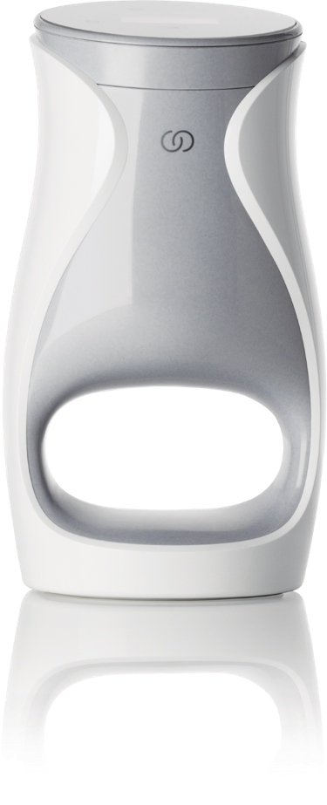
The Future Is Here…Are You Ready?

