Slide 1


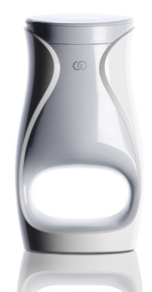
FORMULATIONS, MICROLAYERING TECHNOLOGY AND RESEARCH AND CLINICAL RESULTS

Slide 2
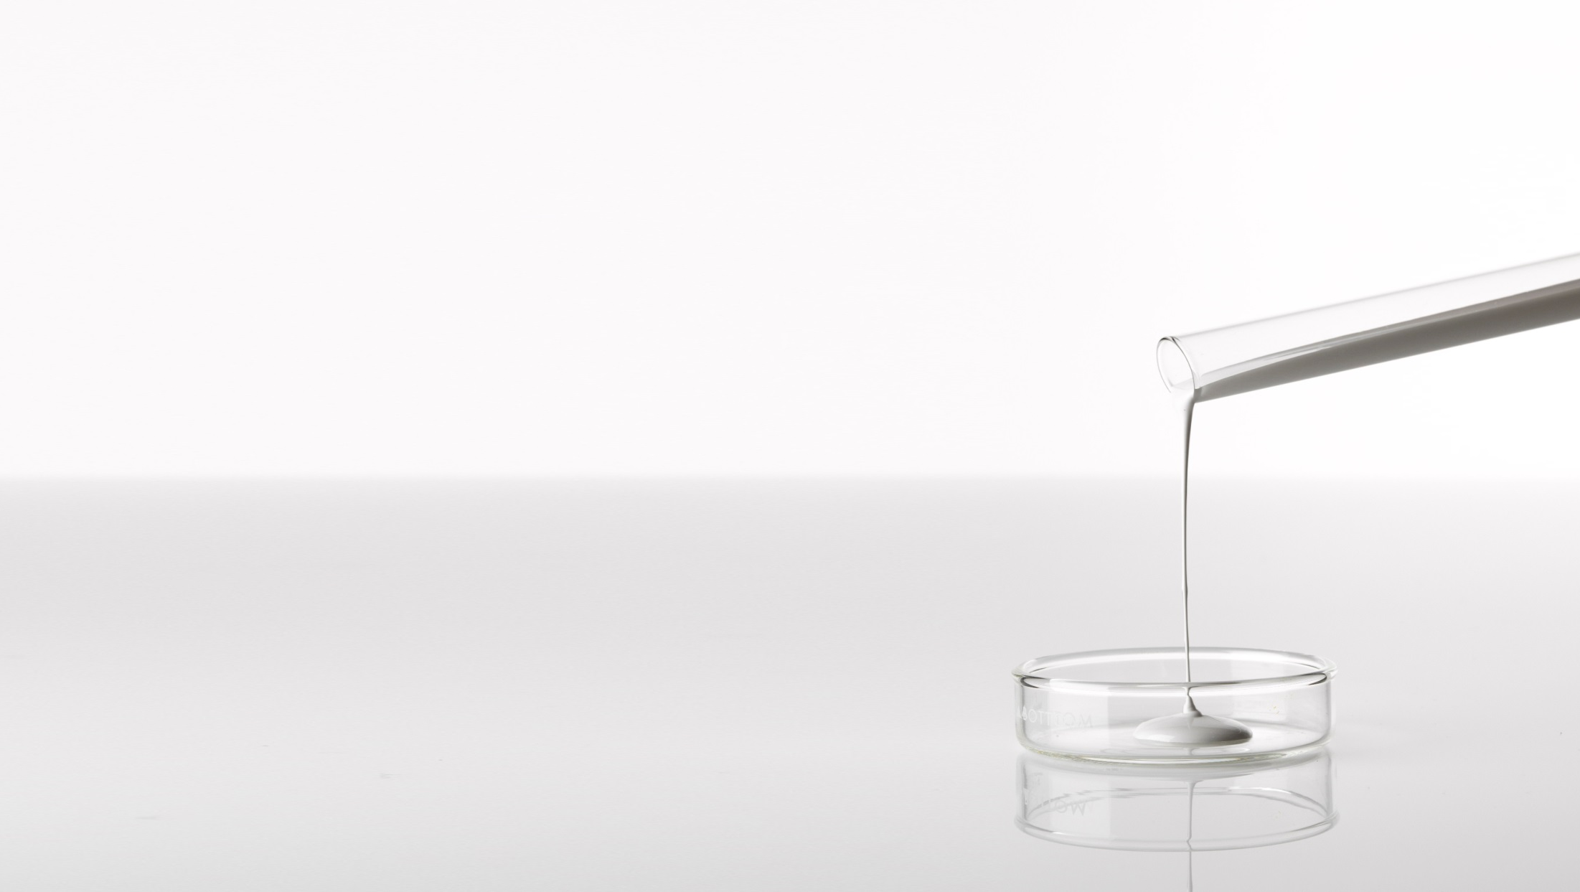
WE ARE AN ANTI-AGING LEADER
ageLOC Me™ delivers Nu Skin’s most advanced anti-aging science
in a unique and impressive system for a completely new skin care experience. ageLOC® products target the sources of aging to help you look and feel younger.
Nu Skin’s most advanced ageLOC formulations are inspired by more than 30 years of anti-aging science
Science that targets aging at its source
Cutting-edge, breakthrough products developed by
anti-aging experts
Patents issued for function and design
Notes:
As part of Nu Skin’s exclusive anti-aging science, we are consistently identifying new ageLOC ingredients that can target the sources of aging to reduce the appearance of aging in the skin. This ongoing endeavor has allowed us to expand our ingredient blends. At present we have identified a new and unique blend of ingredients that addresses the sources of aging at a more complex level. Our research has now brought us to a place where the ingredients can begin to offset the environmental influences that may lead to premature aging. This is our best ageLOC yet.

Slide 3
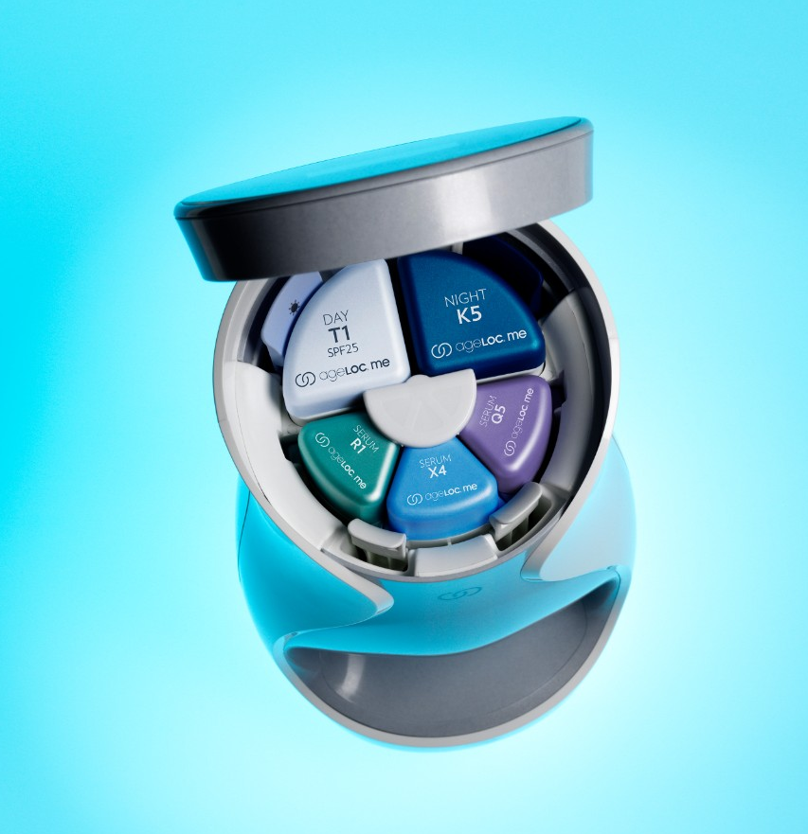
SUPER SERUMS
Higher concentration of ingredients
Combine to provide a higher amount and potency of key ingredients that could not be formulated into a single product
Notes:
Designed with customization in mind, we have separated the “treatment” products into three separate serums. This novel approach allows for three targeted serums with ingredients focused on particular skin concerns that combine prior to use. So not only does it allow for customization, but it enables a larger array of key ingredients at potentially higher concentrations than what we could easily formulate into a single product. This results in a better product for you.

Slide 4
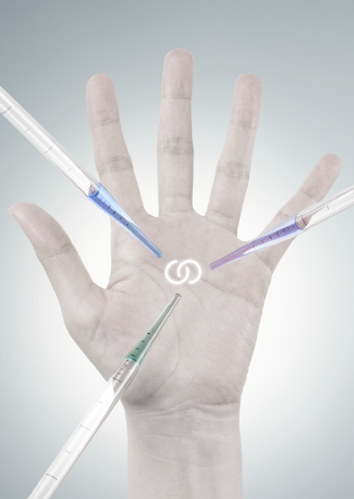
FORMULATED FOR ME
We intentionally separated ingredients into three serums
that target different aging characteristics. The three serums are customized to address individual skin care needs and are delivered at the time of use through microlayering technology.

Slide 5
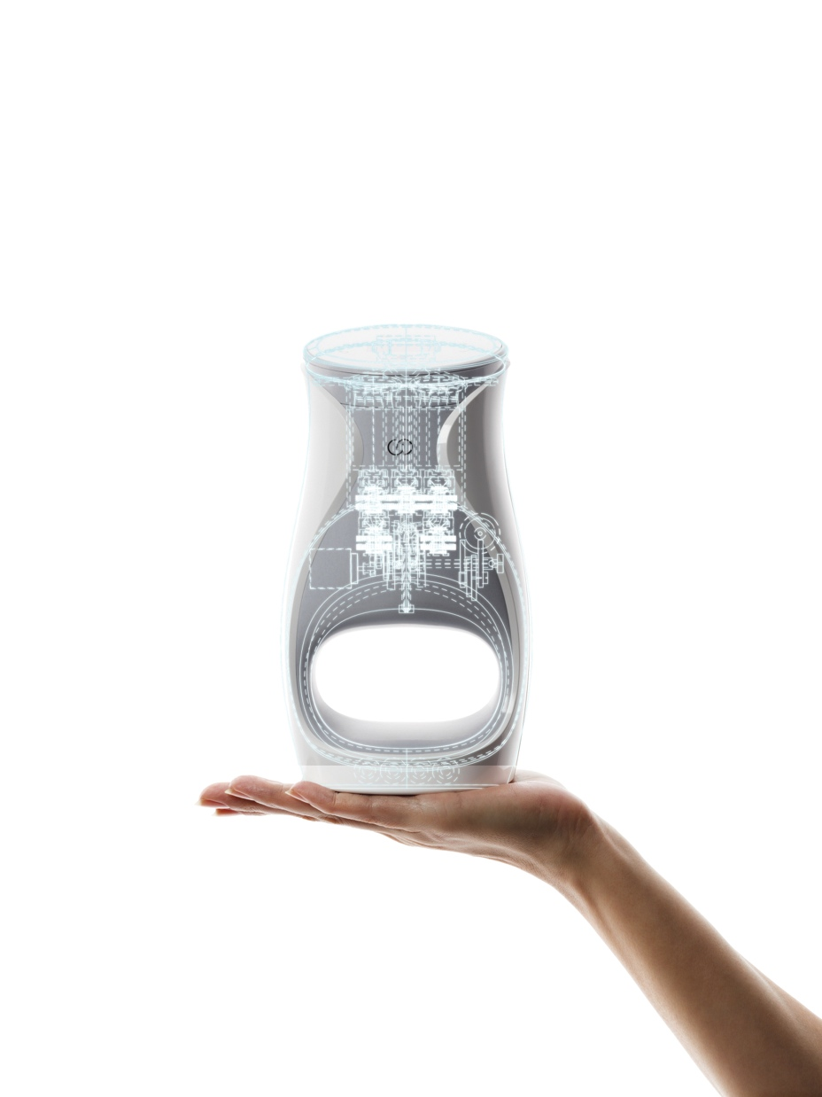
YOUR PERSONAL SKIN CARE LAB
Like having a lab at your home. The device is very unique with microlayering technology that can only happen at moment of use.
Notes:
To help you receive the most advanced anti-aging skin care benefits, Nu Skin built a mini skin care lab for you to have in your home. We are a skin care company and in order to deliver the best benefits for your skin, we needed to develop the device with microlayering technology. The three serums are combined by you at your house for an enhanced experience.

Slide 6
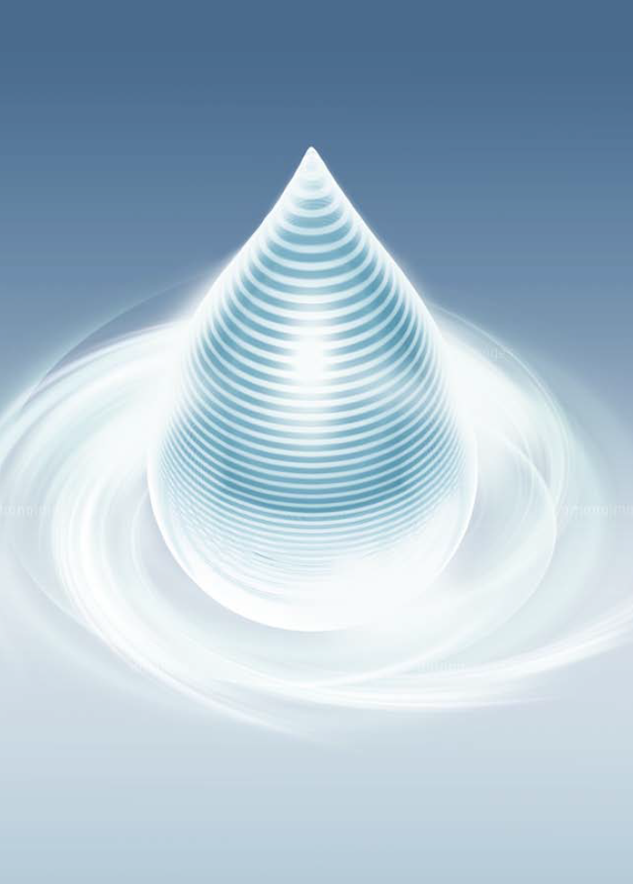
AGELOC ME™ DEVICE
MICROLAYERING TECHNOLOGY
The ageLOC Me device weaves the customized serums into 40 layers to deliver the most effective anti-aging skin care dose possible.
Notes:
The ageLOC Me device weaves the customized serums together into 40 layers to evenly distribute the key ingredients, optimizing the serum combination and resulting in increased absorption of anti-aging formulations into the skin.

Slide 7
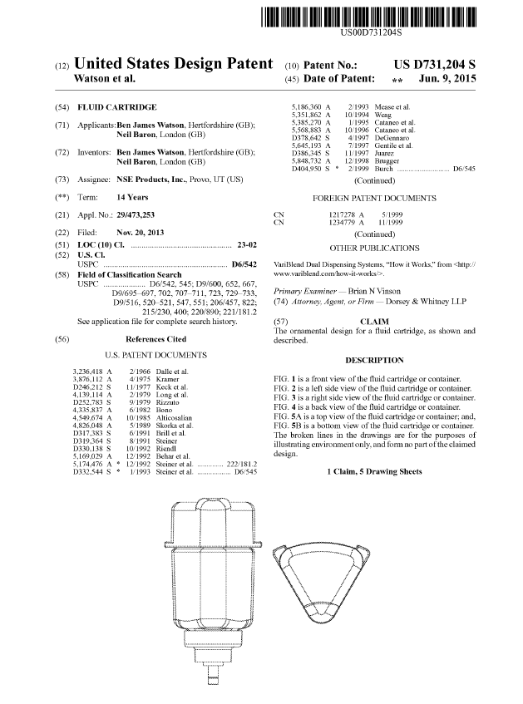
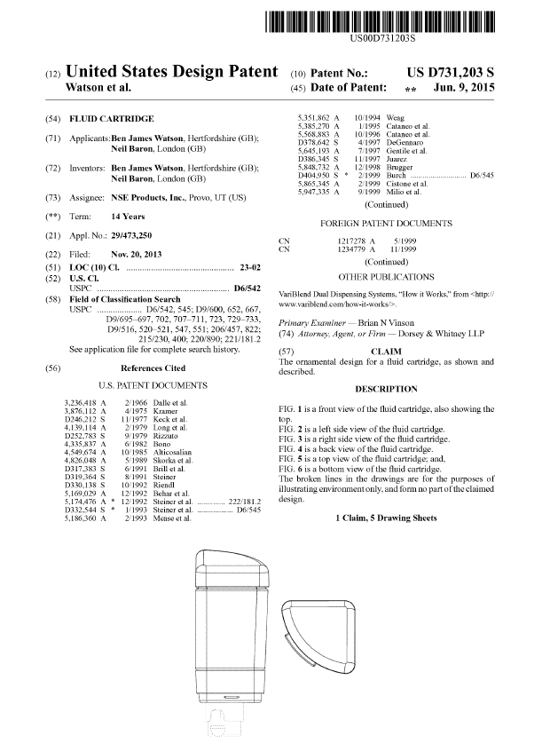
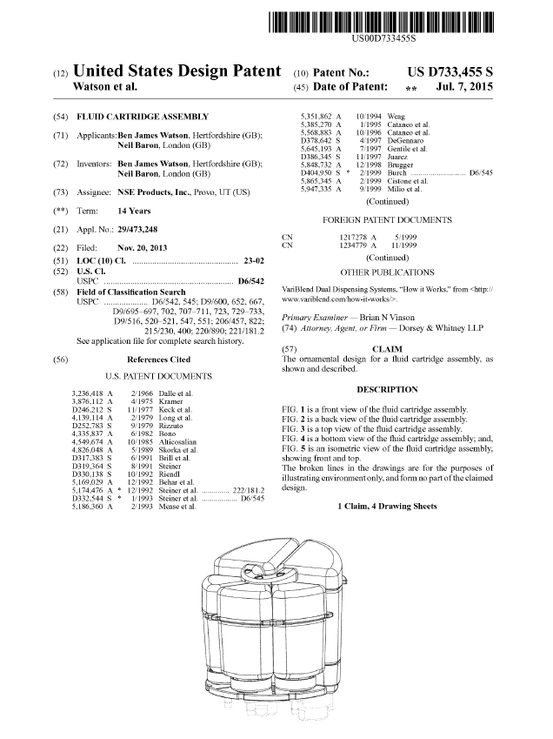
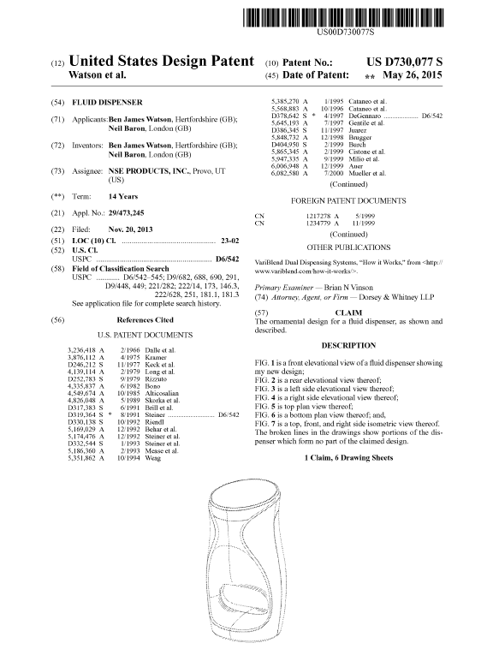
FIVE NEW PATENTS RELATED TO MECHANISMS FOR DELIVERING CUSTOMIZED SKIN CARE
Notes:
Our ageLOC Me patents cover mechanisms for delivering customizable skin care (fluid cartridge, device, and assembly). We have protected our intellectual property to ensure that no one else can sell what you (the distributor) are selling. Our patents help ensure there is no concern of others copying our intellectual property and making the same claims.

Slide 8
KEY SELLING POINTS
FORMULATED
FOR ME
DELIVERED AT THE MOMENT OF USE
MICROLAYERING TECHNOLOGY

Slide 9
RESEARCH &
CLINICAL RESULTS

Slide 10
THE RESULT: 3x MORE PENETRATION/ABSORPTION INTO SKIN* AND
MORE ACTIVES DISTRIBUTED EVENLY INTO THE SKIN—BETTER RESULTS
AGELOC ME™ MICROLAYERING TECHNOLOGY WITH AGELOC ME™ DEVICE
Serums
R
X
This image is of a cross-section drawing of skin (stratum corneum)
3x
Q
* Combining the three serums using the ageLOC Me device (ageLOC Me microlayering technology) results in improved absorption into the skin as compared to hand mixing.
* “Absorption into the skin” refers to the stratum corneum.
* 3x was calculated by dividing the average data points of combining through device (microlayering technology) vs. hand mixing
Stratum Corneum
This chart shows each serum is evenly distributed using microlayering technology; thus all three serums maintain their active power.
MIXED BY HAND WITHOUT AGELOC ME™ DEVICE
R
Serums
X
This image is of a cross-section drawing of skin (stratum corneum)
Q
Stratum Corneum
This chart shows serums not evenly distributed because they were mixed by hand.
Notes:
Nu Skin (2015). [In-Vitro Data Illustrating the Differences in Skin Absorption Based on Combination Methods of ageLOC Me Serums]. Unpublished raw data.
During our development we were concerned that combining the three serums inadequately would allow for hot spots or missed areas on the skin. We have identified that through the ageLOC Me device the serums are evenly dispersed. This ensures that all three serums are adequately spread throughout the combination prior to application on the skin, therefore when applied each serum will reach and is equally represented in all areas of the application site—your face.
Additionally, we commissioned a third party testing house to measure the differences in absorption of a key ingredient when the serums are combined via the ageLOC Me device versus when the device was not used. Amazingly, the ageLOC Me Device combination resulted in three times better absorption into the stratum corneum than the non-ageLOC Me serum combination. This shows another benefit of the ageLOC Me Device; it is undoubtedly a key part of the ageLOC Me System.

Slide 11
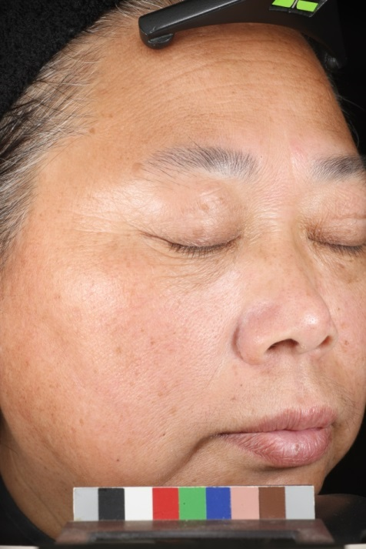
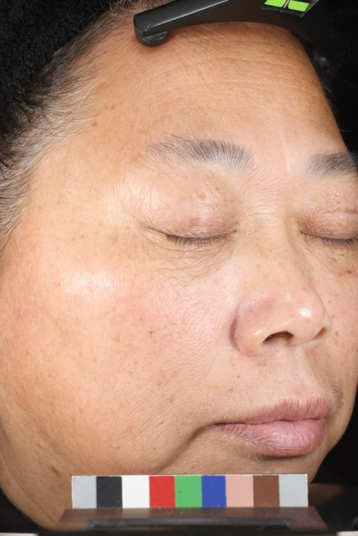
Clinical Results: Subject 1 after 12 weeks
Before
After
Visible improvements in crow’s feet
Prepared for Nu Skin (2015). [12-Week Clinical Study to Evaluate Anti-aging Efficacy of ageLOC Me™ Serums]. Unpublished raw data.
The pictures shown were taken at baseline and at the conclusion of a 12 Week clinical study Nu Skin contracted out to a 3rd party research organization in China. 60 participants were recruited and were split into two groups. Each participant was randomly assigned to one of two predominant ageLOC Me serum combination. Clinical grading, self-assessment, instrumentation and photos were completed at Baseline, Weeks 1, 2, 4, 8 and 12. October 2015.
Notes:
Prepared for Nu Skin (2015). [12-Week Clinical Study to Evaluate Anti-aging Efficacy of ageLOC Me Serums]. Unpublished raw data.
The pictures shown were taken at baseline and at the conclusion of a 12 Week clinical study Nu Skin contracted out to a 3rd party research organization in China. 60 participants were recruited and were split into two groups. Each participant was randomly assigned to one of two predominant ageLOC Me serum combination. Clinical grading, self-assessment, instrumentation and photos were completed at Baseline, Weeks 1, 2, 4, 8 and 12. October 2015.

Slide 12
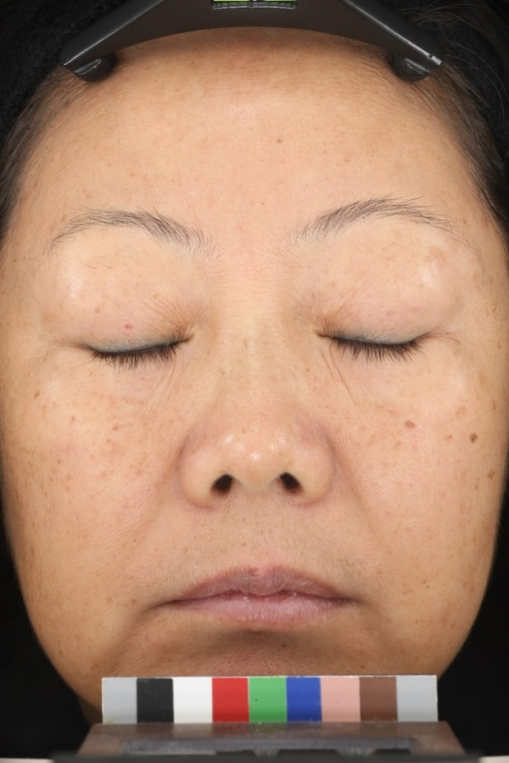
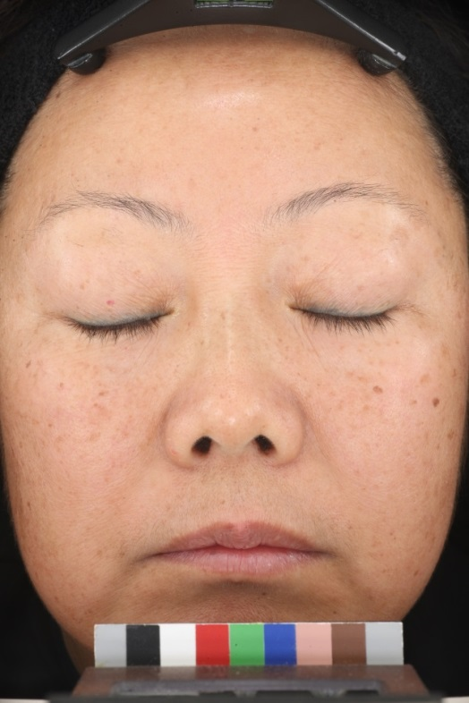
Clinical Results: Subject 2 after 12 weeks
Before
After
Visible improvements in eye wrinkles
Prepared for Nu Skin (2015). [12-Week Clinical Study to Evaluate Anti-aging Efficacy of ageLOC Me™ Serums]. Unpublished raw data.
The pictures shown were taken at baseline and at the conclusion of a 12 Week clinical study Nu Skin contracted out to a 3rd party research organization in China. 60 participants were recruited and were split into two groups. Each participant was randomly assigned to one of two predominant ageLOC Me serum combination. Clinical grading, self-assessment, instrumentation and photos were completed at Baseline, Weeks 1, 2, 4, 8 and 12. October 2015.
Notes:
Prepared for Nu Skin (2015). [12-Week Clinical Study to Evaluate Anti-aging Efficacy of ageLOC Me Serums]. Unpublished raw data.
The pictures shown were taken at baseline and at the conclusion of a 12 Week clinical study Nu Skin contracted out to a 3rd party research organization in China. 60 participants were recruited and were split into two groups. Each participant was randomly assigned to one of two predominant ageLOC Me serum combination. Clinical grading, self-assessment, instrumentation and photos were completed at Baseline, Weeks 1, 2, 4, 8 and 12. October 2015.

Slide 13
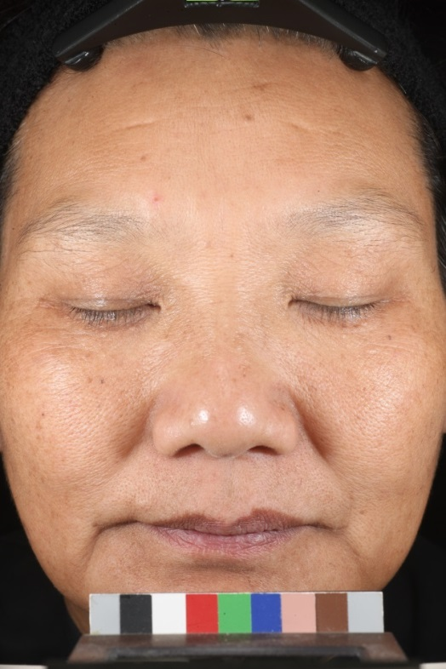
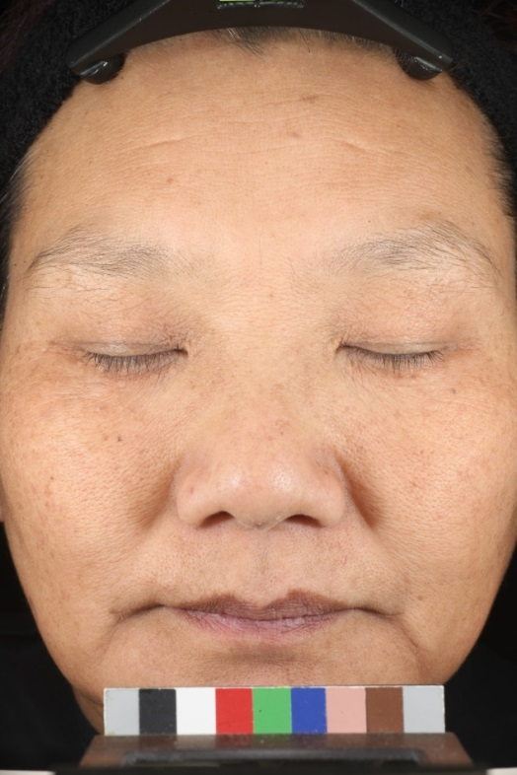
Clinical Results: Subject 3 after 12 weeks
Before
After
Visible improvements in skin tone
Prepared for Nu Skin (2015). [12-Week Clinical Study to Evaluate Anti-aging Efficacy of ageLOC Me™ Serums]. Unpublished raw data.
The pictures shown were taken at baseline and at the conclusion of a 12 Week clinical study Nu Skin contracted out to a 3rd party research organization in China. 60 participants were recruited and were split into two groups. Each participant was randomly assigned to one of two predominant ageLOC Me serum combination. Clinical grading, self-assessment, instrumentation and photos were completed at Baseline, Weeks 1, 2, 4, 8 and 12. October 2015.
Notes:
Prepared for Nu Skin (2015). [12-Week Clinical Study to Evaluate Anti-aging Efficacy of ageLOC Me Serums]. Unpublished raw data.
The pictures shown were taken at baseline and at the conclusion of a 12 Week clinical study Nu Skin contracted out to a 3rd party research organization in China. 60 participants were recruited and were split into two groups. Each participant was randomly assigned to one of two predominant ageLOC Me serum combination. Clinical grading, self-assessment, instrumentation and photos were completed at Baseline, Weeks 1, 2, 4, 8 and 12. October 2015.

Slide 14
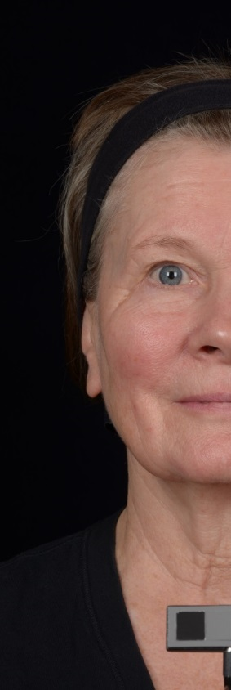
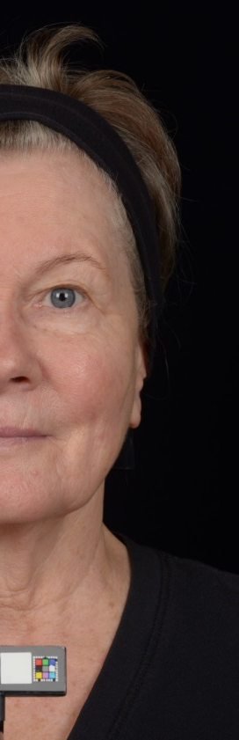
Clinical Results: Subject A after 16 weeks
Before
After
Skin tone is more even
Forehead wrinkles appear smoother
Prepared for Nu Skin (2015). [16-Week Clinical Study to Evaluate Anti-aging Efficacy of ageLOC Me™ Serums]. Unpublished raw data.
The pictures shown were taken at baseline and at the conclusion of a 16 Week clinical study Nu Skin contracted out to a 3rd party research organization in the United States. 60 participants were recruited and were split into two groups. Each participant was randomly assigned to one of two predominant ageLOC Me serum combination. Clinical grading, self-assessment, instrumentation and photos were completed at Baseline, Weeks 1, 4, 8, 12 and 16. March 2015.
Notes:
Prepared for Nu Skin (2015). [16-Week Clinical Study to Evaluate Anti-aging Efficacy of ageLOC Me Serums]. Unpublished raw data.
The pictures shown were taken at baseline and at the conclusion of a 16 Week clinical study Nu Skin contracted out to a 3rd party research organization in the United States. 60 participants were recruited and were split into two groups. Each participant was randomly assigned to one of two predominant ageLOC Me serum combination. Clinical grading, self-assessment, instrumentation and photos were completed at Baseline, Weeks 1, 4, 8,12 and 16. March 2015.

Slide 15
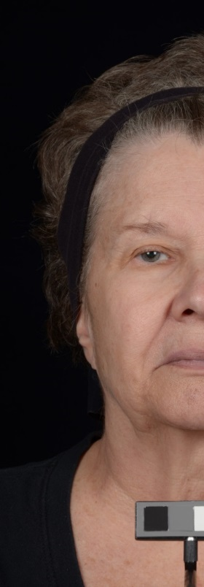
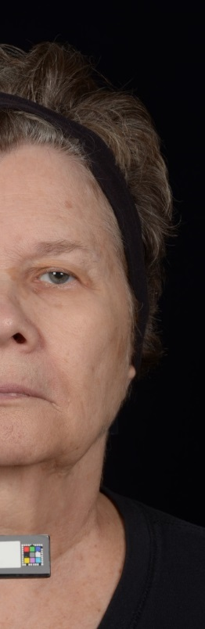
Clinical Results: Subject B after 16 weeks
Before
After
Reduced prominence of nasolabial fold
Prepared for Nu Skin (2015). [16-Week Clinical Study to Evaluate Anti-aging Efficacy of ageLOC Me™ Serums]. Unpublished raw data.
The pictures shown were taken at baseline and at the conclusion of a 16 Week clinical study Nu Skin contracted out to a 3rd party research organization in the United States. 60 participants were recruited and were split into two groups. Each participant was randomly assigned to one of two predominant ageLOC Me serum combination. Clinical grading, self-assessment, instrumentation and photos were completed at Baseline, Weeks 1, 4, 8, 12 and 16. March 2015.
Notes:
Prepared for Nu Skin (2015). [16-Week Clinical Study to Evaluate Anti-aging Efficacy of ageLOC Me Serums]. Unpublished raw data.
The pictures shown were taken at baseline and at the conclusion of a 16 Week clinical study Nu Skin contracted out to a 3rd party research organization in the United States. 60 participants were recruited and were split into two groups. Each participant was randomly assigned to one of two predominant ageLOC Me serum combination. Clinical grading, self-assessment, instrumentation and photos were completed at Baseline, Weeks 1, 4, 8,12 and 16. March 2015.

Slide 16
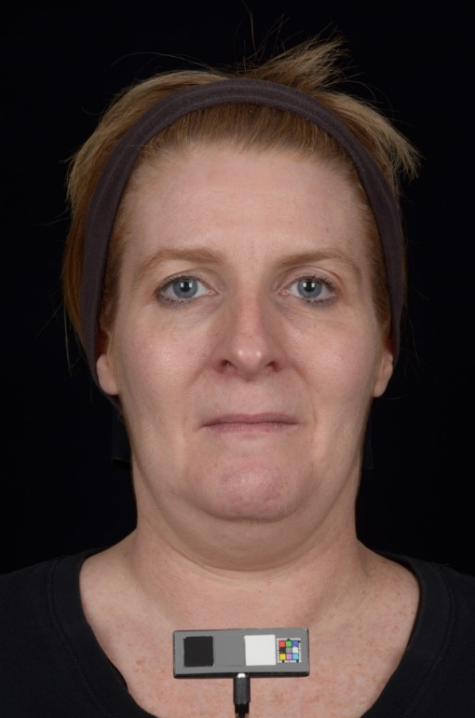
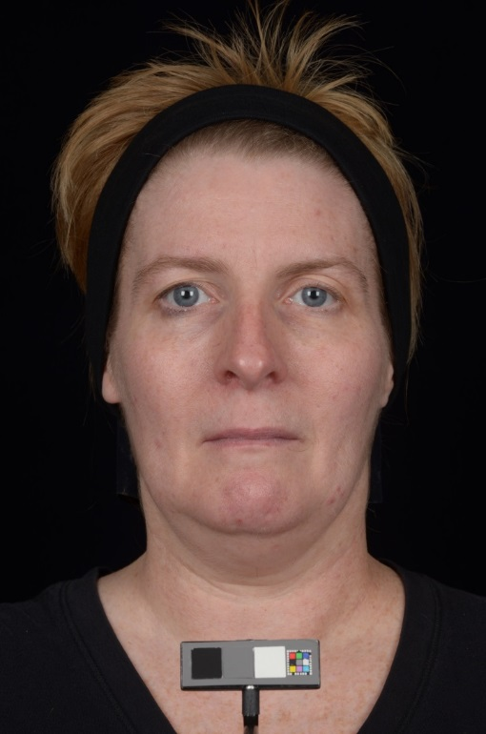
Clinical Results: Subject C after 16 weeks
Reduced prominence of nasolabial fold
Softening of marionette line
Before
After
Prepared for Nu Skin (2015). [16-Week Clinical Study to Evaluate Anti-aging Efficacy of ageLOC Me™ Serums]. Unpublished raw data.
The pictures shown were taken at baseline and at the conclusion of a 16 Week clinical study Nu Skin contracted out to a 3rd party research organization in the United States. 60 participants were recruited and were split into two groups. Each participant was randomly assigned to one of two predominant ageLOC Me serum combination. Clinical grading, self-assessment, instrumentation and photos were completed at Baseline, Weeks 1, 4, 8, 12 and 16. March 2015.
Notes:
Prepared for Nu Skin (2015). [16-Week Clinical Study to Evaluate Anti-aging Efficacy of ageLOC Me Serums]. Unpublished raw data.
The pictures shown were taken at baseline and at the conclusion of a 16 Week clinical study Nu Skin contracted out to a 3rd party research organization in the United States. 60 participants were recruited and were split into two groups. Each participant was randomly assigned to one of two predominant ageLOC Me serum combination. Clinical grading, self-assessment, instrumentation and photos were completed at Baseline, Weeks 1, 4, 8,12 and 16. March 2015.

