Slide 1
6S Quality Process

Slide 2
6S Quality Process

Slide 3
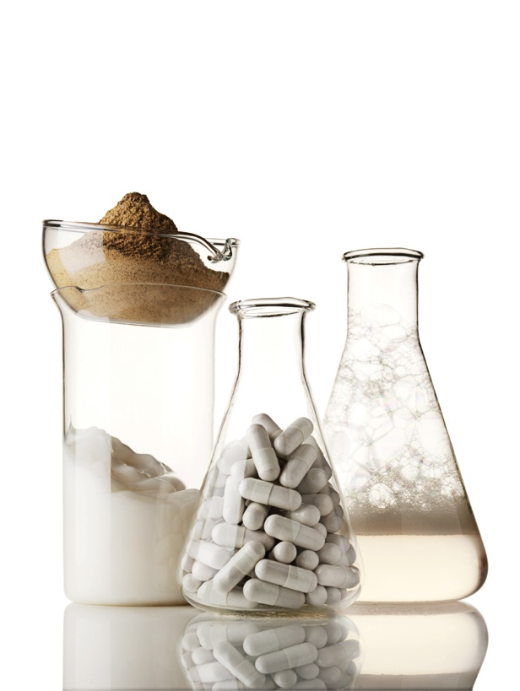
6S Quality Process
Our 6S Quality Process is an innovative six-step approach we use during product development to
ensure our products are:
Safe
Effective
Of the highest quality
Compliant with all applicable
government requirements
Notes:
From the basic raw materials to the final product, we have integrated sound science into each of the steps of product development to create safe and effective products.

Slide 4
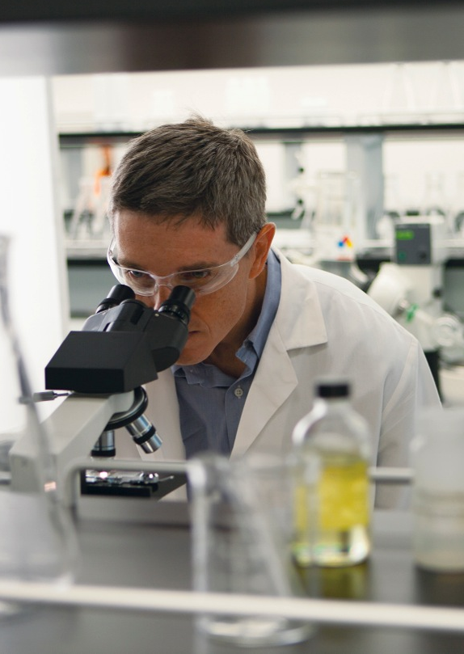
6S Quality Process
Requirements
Rigorous, highly integrated
activities for testing and validating
product integrity
Multiple layers of scientific research
and testing
Attention to detail
Consistent collaboration
Unified commitment to quality
Notes:
It is critical to have foundational principles to guide our product development that involves key departments like Quality, Development, Research, Marketing, etc.. to provide a unified approach to safety, quality, and efficacy throughout each stage of the process.

Slide 5
6S Quality Process History
In 1996, Pharmanex created the 6S Quality Process to ensure its nutritional products exceeded industry standards.
Notes:
Pharmanex originally developed the 6S Quality Process as a basis for safe and effective product development. Our Nu Skin personal care team has always operated under a similar stringent research and development process to ensure the quality, efficacy and safety of our skin care formulations, but we didn’t establish an official name for the personal care process.

Slide 6
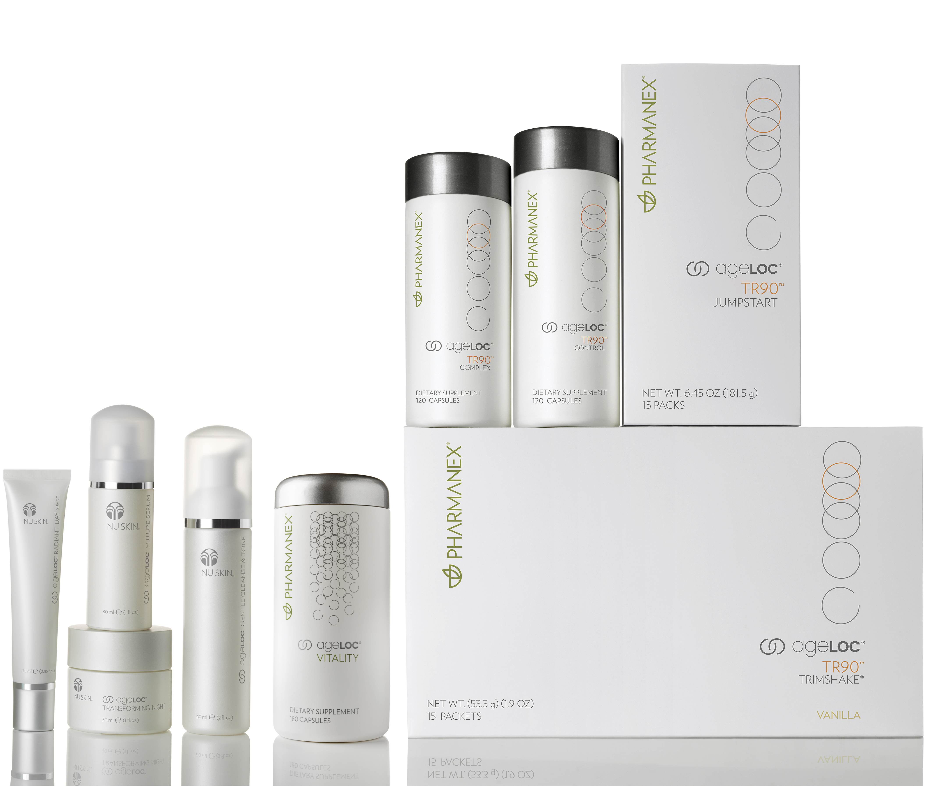
6S Quality Process Today
Today, this process is the key to the consistent quality in our nutritional and personal care products.
Notes:
Nu Skin’s high-quality scientific rigor applies to all aspects of our research and development. To unify and create a more consistent message about our quality development process and make it simple for our sales leaders to understand and share with others, we have rearticulated our 6S Quality Process to include both Nu Skin and Pharmanex quality processes.

Slide 7
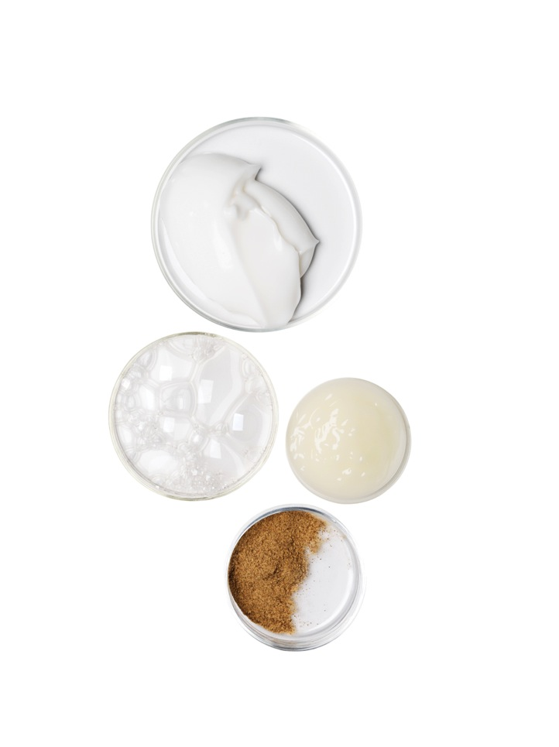
Selection
We work with experts and raw material suppliers around the world to identify the best ingredients for our products based on:
Effectiveness
Suitability for formulation
Consumer safety
Notes:
Selection is the first step of the 6S process, and it includes selecting ingredients based on a scientific foundation of efficacy, safety, and quality. Our scientists review scientific journals and collaborate with each other and, when necessary, outside collaborators. Experts from a variety of scientific fields, such as nutrition, biology, immunology, chemistry, biochemistry, and dermatology help us select ingredients that meet our criteria for inclusion in Pharmanex and Nu Skin products.

Slide 8
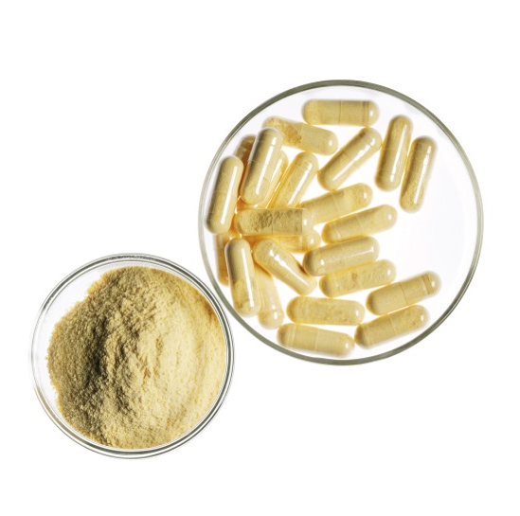
Selection
An example of how we apply Selection to our nutritional products
Studies have shown that probiotics are extremely beneficial for the human body and digestive tract. For ProBio PCC, we selected a unique strain called Lactobacillus fermentum PCC that met our criteria of:
pH survival
Colonization
Identity
Dosing
Notes:
Pharmanex example: One Pharmanex example of Selection is ProBio PCC. Studies have shown that probiotics are extremely beneficial for the human body and digestive tract. We selected a unique strain called Lactobacillus fermentum PCC that met our criteria of pH survival, intestinal colonization, identity, and dosing. Some probiotics survive passage through the digestive tract, which means they are resistant to gastric juices and bile. Some have the ability to colonize in the gut, which means they are able to exert their positive effect in the digestive system. The Probio PCC strain was selected for it’s good stability over the shelf life of the product. Lastly, the Probio PCC strain has a clinically effective dose at the end of the shelf life.

Slide 9
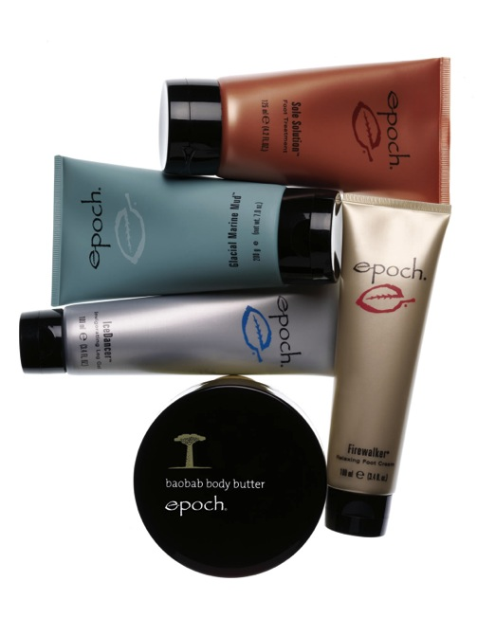
Selection
An example of how we apply Selection to our skin care products
“Ava puhi moni” means “true ava puhi.” Epoch was the first product line to use the correct part of the plant used by the indigenous people of Hawaii.
To cultivate the plant, Nu Skin has established a relationship with an independent agricultural source in Hawaii.
Notes:
Personal Care example: We work with many accredited experts and suppliers in the field of skin care to select the ingredients that are included in our personal care products. For example, ethnobotanists help us to identify botanical ingredients that are used and/or have historically been used for skin benefits. Ava puhi moni products are a good example of the selection step of the 6S process. “ava puhi moni” means “true ava puhi” (the word moni” in Hawaiian means “true”). Epoch was the first line of personal care products to use the correct part of the plant, which the indigenous people of Hawaii also use. To grow and cultivate the ava puhi plant for use in Epoch hair care products, Nu Skin has established a relationship with an independent agricultural source in Hawaii.

Slide 10
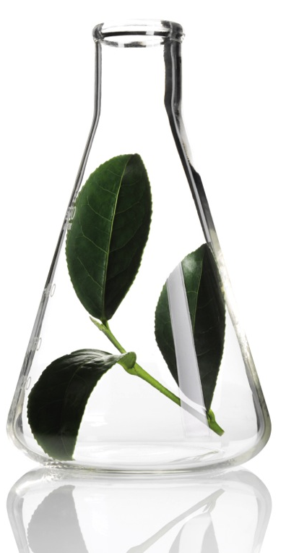
Sourcing
We identify the best source for
ingredients based on:
Availability
Quality
Concentration of key ingredient
components (when applicable)
Notes:
After selecting the ingredients that meet our qualifications, we analyze the source because quality and safe products begin with quality ingredients. Sources may be domestic or international. The quality and concentration of key ingredients are key factors in choosing a supplier.

Slide 11
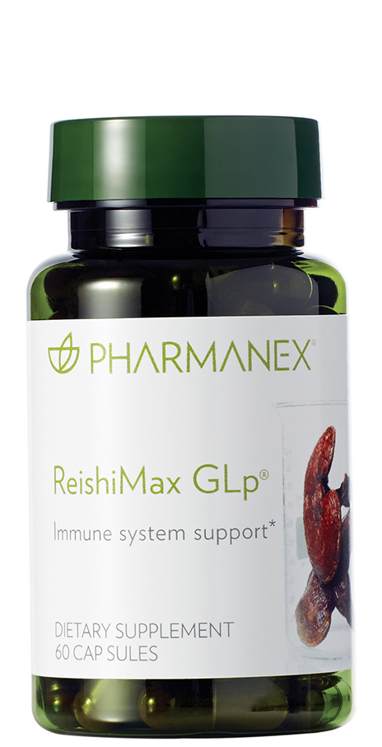
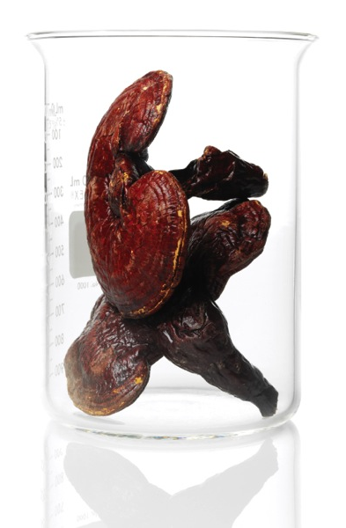
Sourcing
An example of how we apply Sourcing to our nutritional products
There are hundreds of species of reishi, and red reishi produces the highest quality extract. ReishiMax uses red reishi, which we cultivate in carefully controlled conditions.
We use a solid wood log cultivation process with low light and high humidity to create the high-quality reishi extract found in the wooded mountains of southeast China.
Notes:
Pharmanex example: If a raw ingredient is below the standards we set, we do not accept it. For example, our ReishiMax is sourced from the a high-quality red reishi called ganoderma lucidum. There are hundreds of species of reishi and the red is preferred because it produces the highest quality extract subject to the most scientific evaluation. In nature, the reishi mushroom grows on the sides of trees and stumps in the densely wooded mountains of southeast China. To create the same quality found in nature, Pharmanex uses a solid wood log cultivation process where we carefully control critical conditions, including low light and high humidity, to create our high-quality reishi extract in ReishiMax.

Slide 12
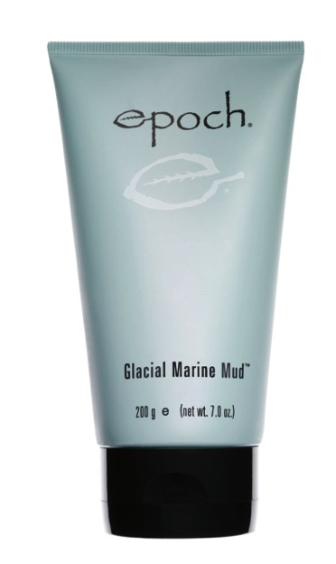
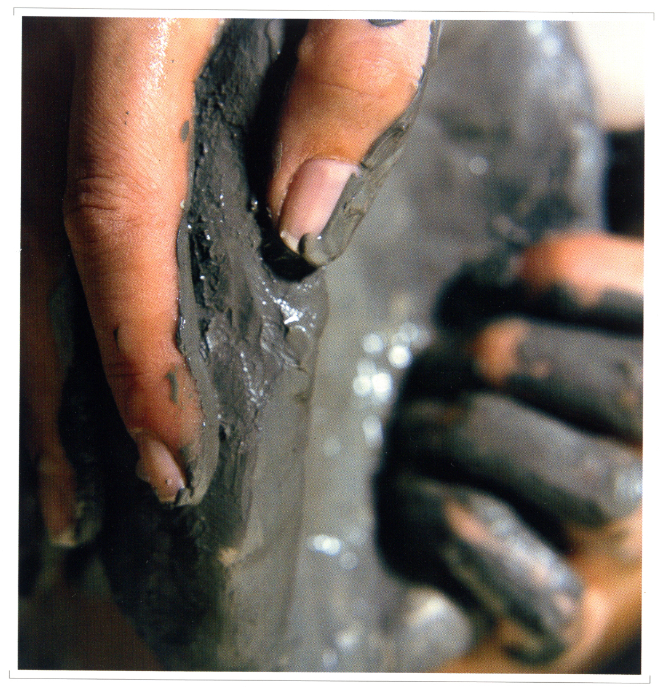
Sourcing
An example of how we apply Sourcing to our skin care products
Our Glacial Marine Mud is obtained from a remote glacial estuary in the Pacific Northwest where the mud is covered by 8 to 10-foot tides every day. When the tide recedes, the mud is mined. This mud:
Is continuously enriched by the ocean, giving
it more than 50 beneficial minerals and trace elements
Goes through an exclusive homogenization process to refine its particle size and create a highly absorbent mud
Hydrates and cleanses with impeccable consistency
Notes:
Personal Care: We get our Glacial Marine Mud from a remote glacial estuary in Northern British Columbia. Every day, the mud is covered by 8-10 foot tides. When the tide goes out, the mud is mined. The upper layer of mud is removed and the mud is harvested from a 3-4 foot depth to ensure consistency. All holes are filled with rocks and the top layer of the mud is replaced. The mud is constantly replenished from the tides and nearby mountain springs. Continuously enriched by the ocean, this unique glacial mud has more than 50 beneficial minerals and trace elements. Its naturally fine colloidal particles and absorbent properties significantly enhance its deep cleansing effect. Through an exclusive homogenization process, its particle size is further refined to create a highly absorbent mud that hydrates and cleanses with impeccable consistency.

Slide 13
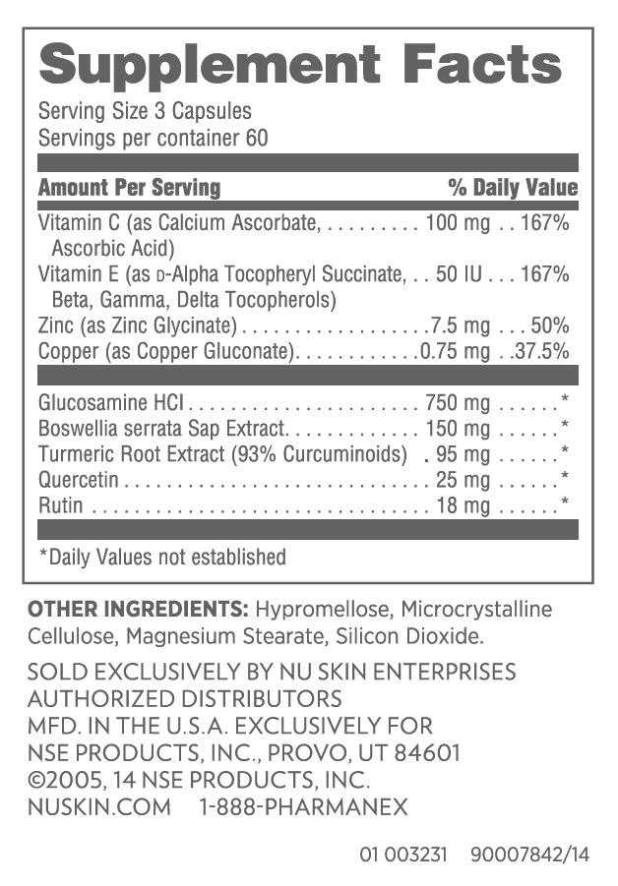
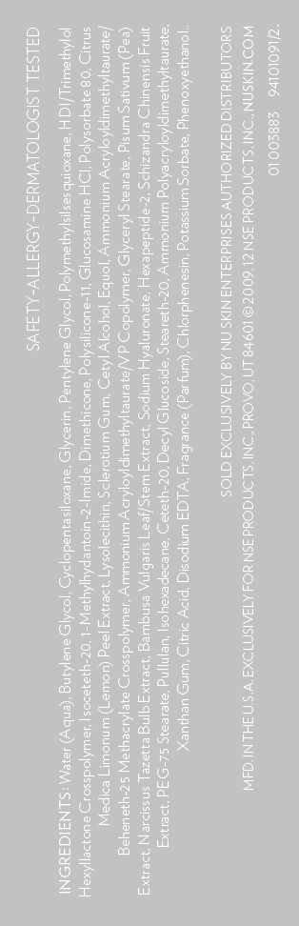
Specification
For finished products, we have created specifications to help establish an approval basis for:
Active compounds
Ingredients
Criteria for finished products
These standards provide specific characteristics to guide consistent manufacturing and finished product approval.
Notes:
The third step in the 6S process is specification. This step overlaps with selection and sourcing because it involves a list of criteria we have established for selecting ingredients from the best sources to guide consistent quality manufacturing and approval of the finished product for sale.

Slide 14
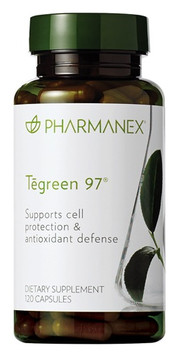
Specification
An example of how we apply Specification to our nutritional products
Using state-of-the-art analytical techniques, we conduct structural analysis
of the natural compounds in selected botanicals.
Tegreen has a 97% polyphenol extract of which 65% are catechins. ReishiMax is standardized to 6% triterpenes and 13.5% polysaccharides.
Notes:
Pharmanex example: It would be a mistake not to dedicate analytical research to identify the declared active components or marker compounds that are part of chosen ingredients. Using state-of-the-art analytical techniques, Pharmanex conducts structural analysis of the natural compounds present in the selected botanicals. Understanding the critical elements of the chemical structure of the desired active helps us select the correct plant part that contains the active. For example, Tegreen has a 97% polyphenol extract of which 65% are catechins. ReishiMax is standardized to 6% triterpenes and 13.5% polysaccharides.

Slide 15
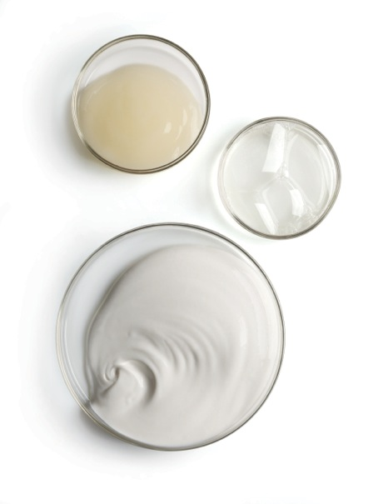
Specification
An example of how we apply Specification to our skin care products
Each personal care product has set specifications for aesthetics, including:
Sensory (cream, gel, lotion, etc.)
Color
Viscosity
pH
We check that each product is within these specifications before we approve any batch for release.
Notes:
Each Personal Care product has set specifications for aesthetics including sensory (cream, gel, lotion, serum, etc.), color, viscosity, pH, specific gravity, etc. We check that each product is within these specifications before we approve any batch for release. This ensures that our customers will have quality, safety and consistency in the products (aesthetics and efficacy) each time they purchase them and that they products will remain stable throughout their shelf life.

Slide 16
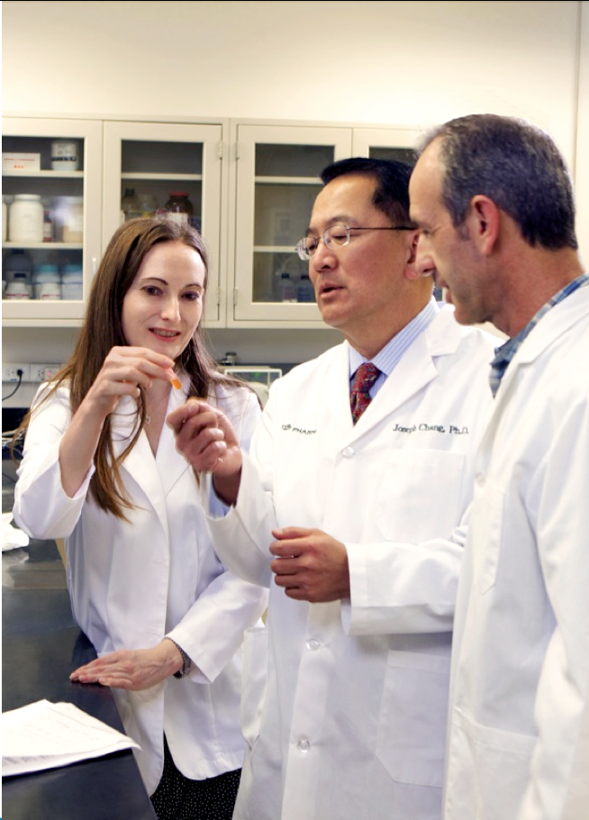
Standardization
Our scientists strive to formulate products containing ingredients at only the most effective levels that provide consistent benefits to the consumer.
We test our products after they’ve been manufactured to ensure they meet our finished good specifications before they leave the manufacturer.
Notes:
To ensure the delivery of the expected safe and effective Nu Skin products, rigorous safety and quality standards have been established. Our scientists understand the importance of standardizing to provide effective levels of ingredients and evaluate essential ingredient activity (where applicable) in every product so you get the same quality and safety from every product, every time.

Slide 17
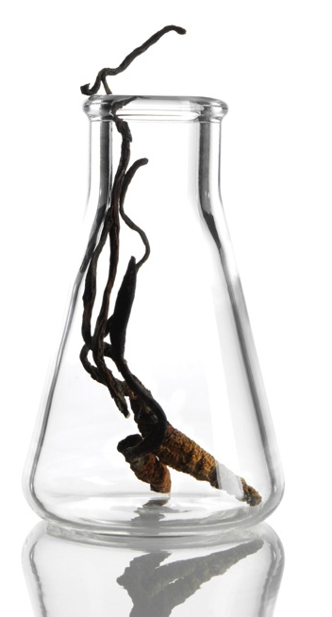
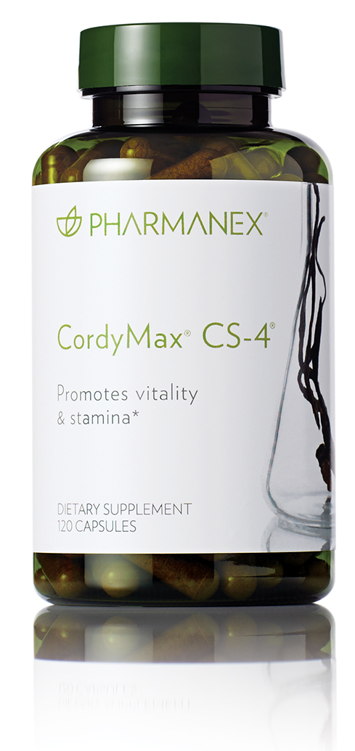
Standardization
An example of how we apply Standardization to our nutritional products
The rare Cordyceps sinensis mushroom grows on the Tibetan plateau at altitudes above 14,000 feet.
We use a documented and consistent fermentation process to produce
Cordymax Cs-4 (a unique strain that is standardized to adenosine and mannitol).
Notes:
Pharmanex example: Cordymax Cs-4 is a standardized extract of Cordyceps sinensis mushroom, which promotes stamina and vitality. The natural mushroom grows on the Tibetan plateau at altitudes above 14,000 feet and is very rare and scarce. So we use a documented and consistent fermentation process to produce Cordymax Cs-4, which is a unique strain that is standardized to adenosine and mannitol to control the process and achieve the quality product as seen in pre-clinical and clinical studies.

Slide 18
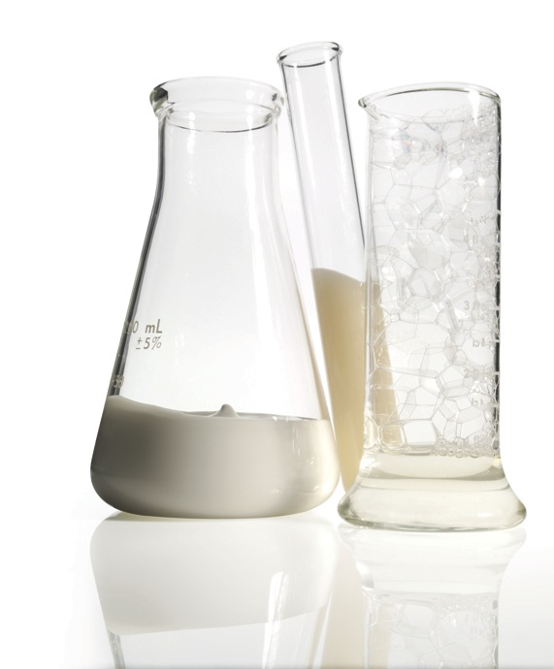
Standardization
An example of how we apply Standardization to our skin care products
Active ingredients are tested at clinically effective doses and are the basis for the standards set.
Compliance with OTC standards established by Regulatory Agencies constitute standards for OTC product classes
In concert with our suppliers, product release standards have been established and followed
Notes:
Personal Care uses ingredients at clinically effective doses. Active ingredients are tested at clinically effective doses and are the basis for the standards set. Compliance with OTC standards established by Regulatory Agencies constitute standards for OTC product classes. In concert with our suppliers, product release standards have been established and followed

Slide 19
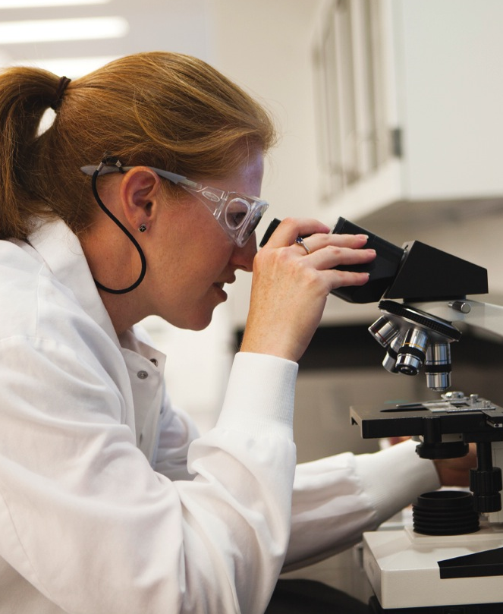
Safety
We use ingredients in safe amounts and conduct standard tests specific to nutrition and personal care to check for:
Presence of microbes
Heavy metal and other contaminates
Irritation potential and/or potential for allergic reactions
Notes:
Safety is woven through all of the steps in the 6S Quality Process. We make sure to select safe ingredients, in safe amounts, and test the final product for the presence of microbes, heavy metals, or other contaminants. In addition with personal care products, we test potential for irritation or allergic reaction.

Slide 20
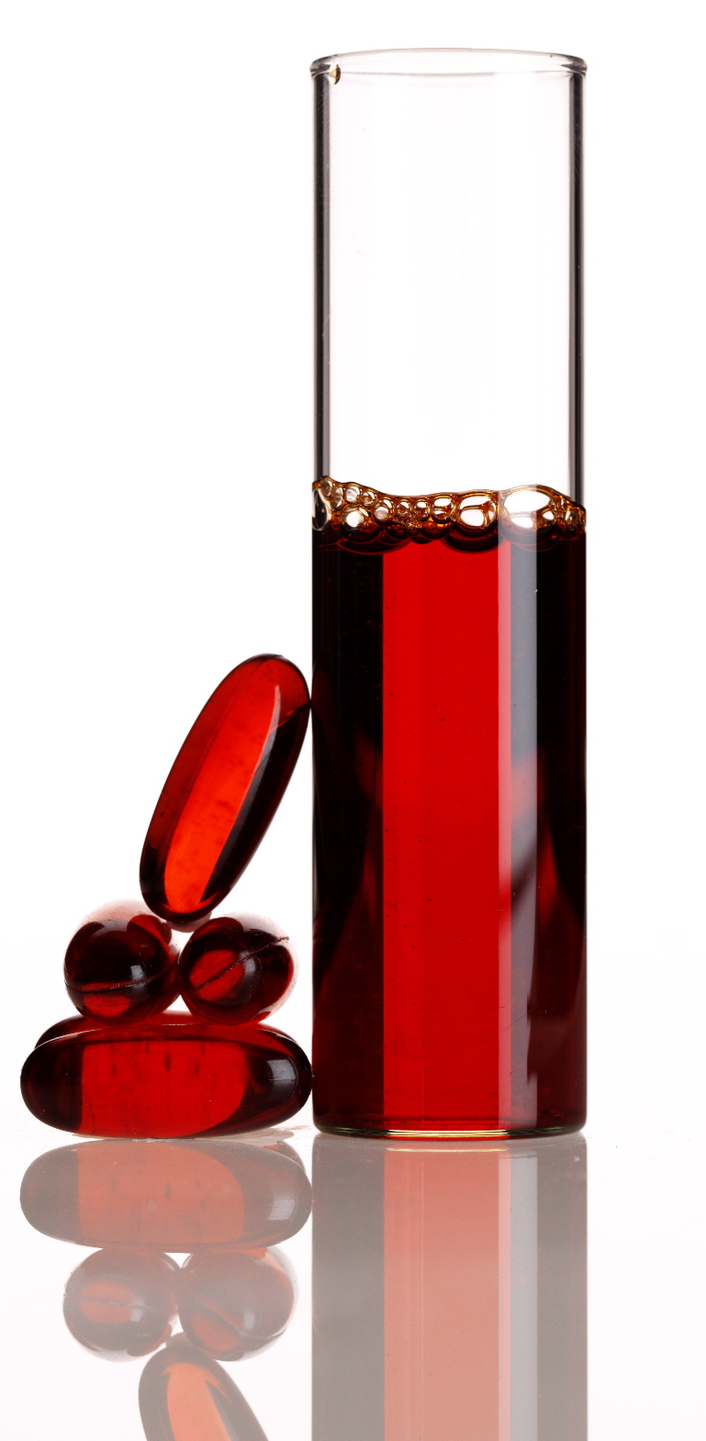
Safety
An example of how we apply Safety to our nutritional products
Marine-sourced materials
can be exposed to high levels of contaminants, so we test our products
(like MarineOmega) for these compounds.
We specify that our sources of
fish and krill oil are pure and harvested from pristine waters.
Notes:
Pharmanex example: Pharmanex tests MarineOmega for heavy metals, pesticides, dioxins, and furans, in addition to standard microbial testing. Marine-sourced materials can sometimes be exposed to high levels of contaminants, so we test our products for these compounds, and we also make sure our source of fish and krill oil are pure and from pristine waters.

Slide 21
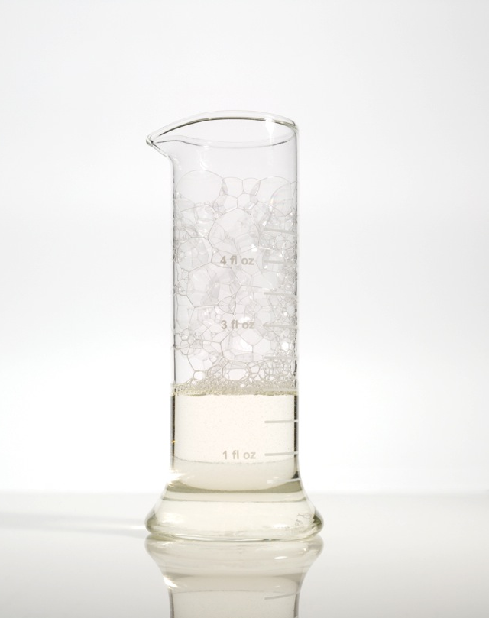
Safety
An example of how we apply Safety to our skin care products
We perform extensive safety testing throughout the entire development process.
To identify formulations that have the lowest irritation potential and further develop these into final products,
we conduct the following evaluations:
irritation
HRIPT
sting panel
Notes:
Personal Care does extensive safety testing throughout the entire development process. We conduct irritation, HRIPT, and sting panel evaluations to identify formulations and iterations that have the lowest irritation potential and further develop these into final products. We extensively test for microbes—bacteria, yeast/molds, pathogens, etc., to ensure your products are safe.

Slide 22
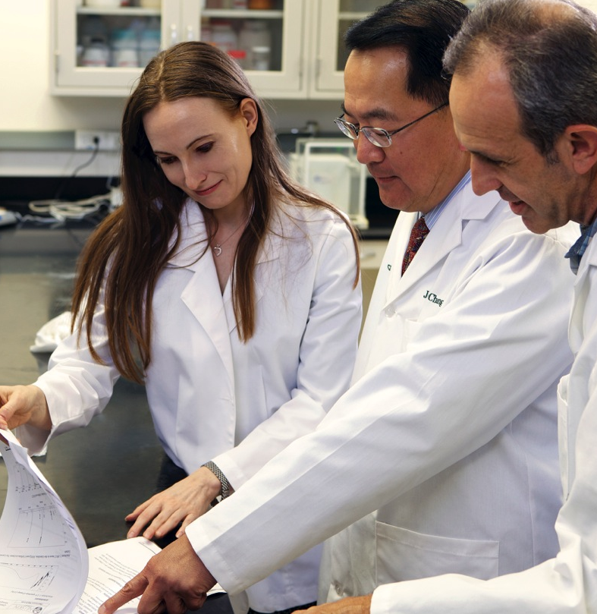
Substantiation
Our products and ingredients are not only safe, but effective.
Our claims are supported by scientific evidence.
Notes:
Creating safe and effective products is at the heart of scientific innovation. We ensure our claims are substantiated with clinical data. Rather than rely on testimonials for evidence, we rely on clinical evidence and conduct our own clinical studies when necessary. Sometimes our research is presented at prestigious scientific conferences, which further substantiates our scientific innovation.

Slide 23
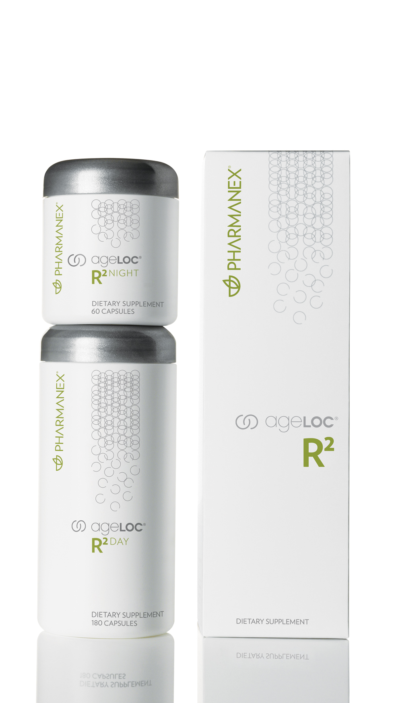
Substantiation
An example of how we apply Substantiation to our nutritional products
Our gene expression science, coupled with literature and clinical studies, has allowed us to explore the genetic causes of aging and identify ingredients to target aging at its source.
Using our proprietary gene database, we developed ageLOC R² to support cellular energy and purification. We’ve conducted many studies on the efficacy of R² and presented our research at numerous conferences around the world.
Notes:
Pharmanex example: Our nutritional product benefits are supported by several scientific studies. These studies confirm that the claims associated with our products are sound. Our claim substantiations are evidence based and not anecdotal.

Slide 24
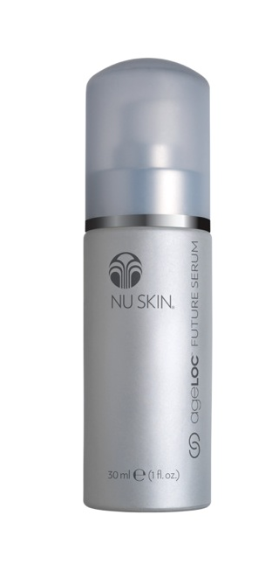
Substantiation
An example of how we apply Substantiation to our skin care products
We not only use key ingredients that have scientific studies behind them to incorporate into our formulas, but we also conduct clinical studies to further substantiate our final formulations.
We then create synopses in the form of clinical bulletins to share with our sales leaders. This type of transparency is rare within the industry.
Notes:
Personal Care not only utilizes key ingredients that have scientific studies behind them to incorporate into our formulas, but we also conduct clinical studies to further substantiate our final formulations. We then create synopses in the form of clinical bulletins for our sales leaders. This type of promotion (and transparency) of our studies is not often seen within our industry.

Slide 25
6S Quality Process
Notes:
Nu Skin and Pharmanex are committed to sound scientific principles throughout every stage of product development to ensure safe and effective products every time.

